Slide 1
Applying the Color Schemes

Slide 2
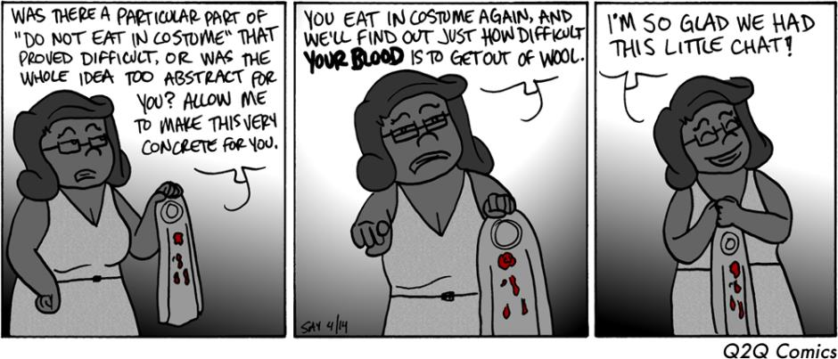
Weekly COW

Slide 3
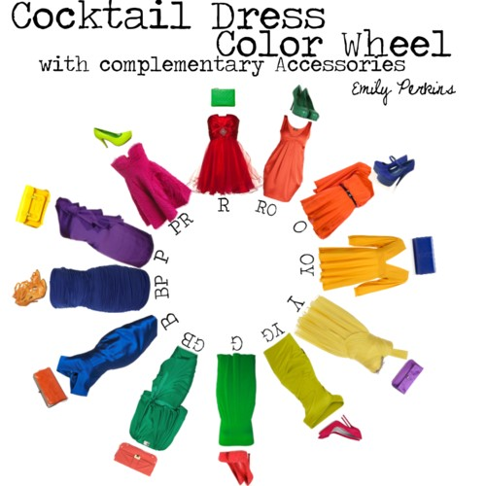
Color Schemes in Fashion

Slide 4

Men’s tie combinations

Slide 5
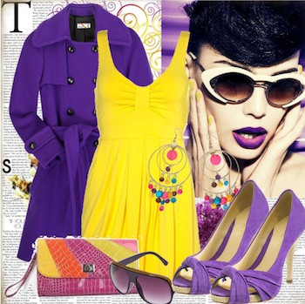
Complementary Colors and Fashion

Slide 6
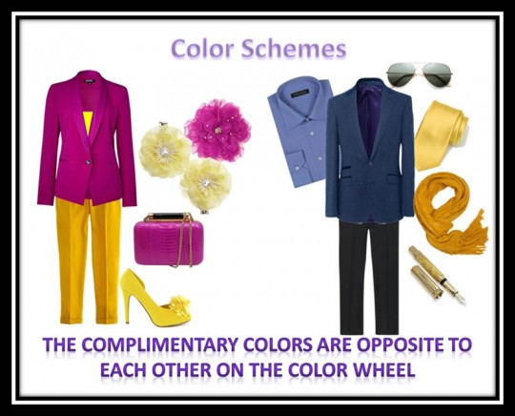
Colors don’t have to be “true shades”….note the fuschia and yellow

Slide 7
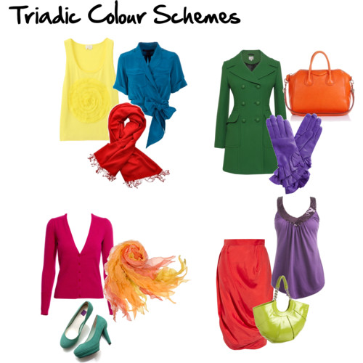
Triadic Color Scheme

Slide 8
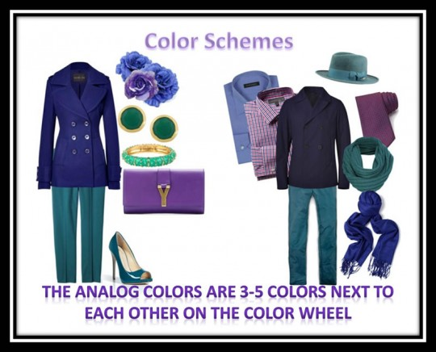
Analogous Color Scheme

Slide 9
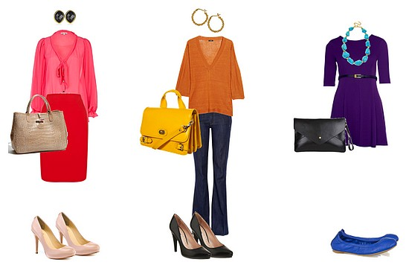
More Analogous

Slide 10
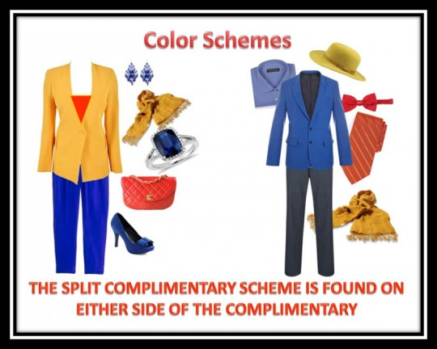
Split Complimentary

Slide 11

Red-Orange + Blue + Green

Slide 12
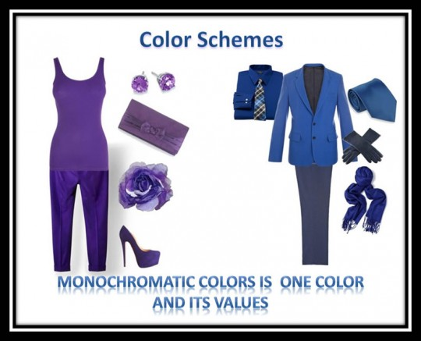
Monochromatic = Shades of one color
Value = Shade = Hue
The value of a color is the same thing as saying the shade or hue of a color.

Slide 13
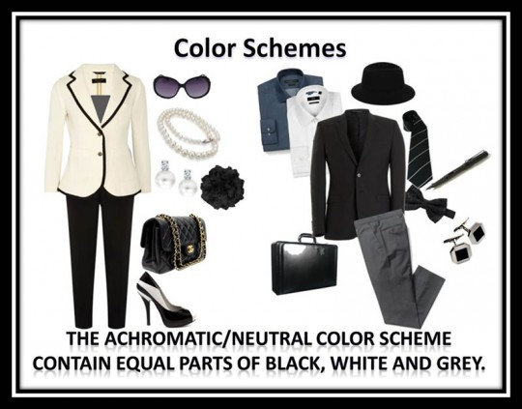
Neutral Color Scheme (What you guys normally wear)

Slide 15

Which color scheme is it?

Slide 16

Which Color Scheme is it?

Slide 17

What color scheme is it?

