Slide 1
Wednesday April 29
Warm Up: What is a costume?

Slide 2
Objective
New Unit Learning Target: SWBAT use history and pictures to create a timeline of clothing and costume, as well as learn the basic sewing skills needed to produce or alter a costume. Students will demonstrate understanding with a final costume research project and a completed hand sewn stuffed animal.

Slide 3
Pop Quiz
From the chapter, name a light weight and extremely breathable fabric. It is a fabric most of you wear every day.
2. Is the body’s natural waist where pants start? If not, where is it?
3. What dulls scissors the fastest?

Slide 4
Finish Vocabulary
You have the next 10 minutes to use the textbook to finish your vocab and questions….go.
Reminder – DO NOT USE THE GLOSSARY

Slide 5
What is a costume?
A costume is any clothing with a purpose.
If I am dressing as a high school student in 2015 (and I am not one), I am wearing a costume.

Slide 6
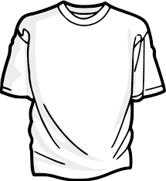
Thursday April 30: WU: Draw the objects below
Draw exactly what you see, not what you think you see.

Slide 7
Objective:
SWBAT review the textbook vocabulary and questions, and begin drawing clothes.

Slide 8
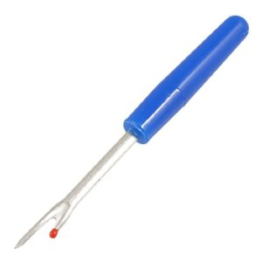
Costume Vocab
Ditty Bag – A small bag placed with your costume for small items like stockings, belts, socks, etc.
Seam Ripper – A small single blade used to cut the threads of a seam, without cutting the fabric

Slide 9
Vocab continued
Tailor’s Chalk – Greased based chalk used to make removable marks on fabric to cut or hem, especially helpful on darker fabrics
Tape Measure – A soft fabric version used to measure the body. The human form is bendy, so therefore you need a soft tape measure.
Sometimes called a soft rule
Question: If you do not have a soft rule, how might you make measurements of the human body?

Slide 10
Question 1
Why does it matter what fabric a costume is made from?
Color and look of fabric on stage and under lights
Drape of the fabric (how the fabric sits)
Washable vs. Not
Weight and warmth
Price and availability
Actor’s allergies

Slide 11
Question 2
What dulls scissors the fastest?
Paper
Scissors should be used to cut one type of material and only one type of material

Slide 12
Question 3
What is a test garment made of and why do we use them?
Muslin – Thin cheap cotton
To test the fit, look and overall construction methods of the garment

Slide 13
Friday May 1
Warm Up: Finish drawing this gown
Objective: SWBAT challenge themselves to draw how real clothes look, by following the visual line of each piece.
NOTE – All drawings attempts will be due Tuesday, so don’t lose them.

Slide 14
Drawing 1

Slide 15
Drawing 2

Slide 16
Drawing 3

Slide 17
Drawing 4

Slide 18
Drawing 5

Slide 19
Drawing 6

