Slide 1
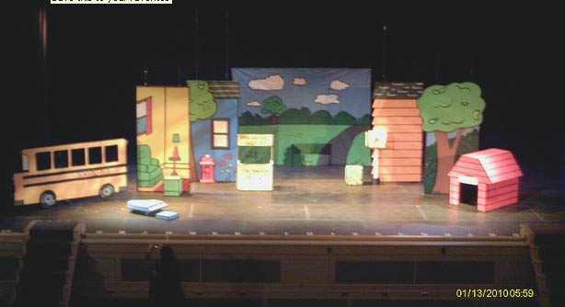
1/20: Warm Up = What type of set is pictured below? How do you know that?
Q.O.D: What is your favorite television show?

Slide 2
Daily Learning Target:
SWBAT differentiate the different elements of design and analyze how this applies to theatrical scenery.
Elements of Design:
Line
Shape
Color
Texture
Space
Proportion

Slide 3
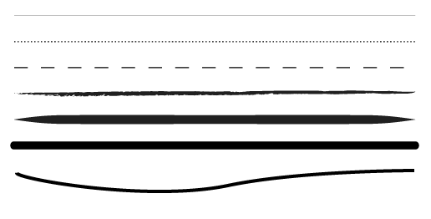
Line
Definition:
First and most basic element of design
Stoke of pen or pencil OR the point at which two lines meet
Use for diving space and drawing the eye to a specific location
Ex. How a magazine uses line to separate content on a page

Slide 4
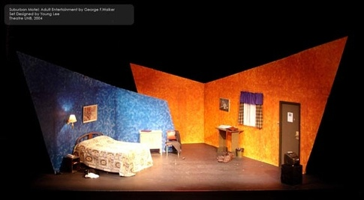
Line in the Theatre World
Line in theatre has as much to do with the sight lines (sight lines = the angles at which the audience views the show) as it also does with the point of the focus

Slide 5
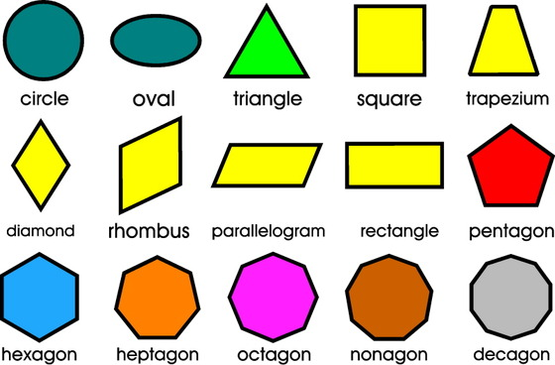
Shape
Definition:
Adding shape on stage adds interest
Defined by a border (either with lines or color)
Used to emphasize a portion of the space
Since everything is a form of a shape, you need to consider how shapes work together.

Slide 6
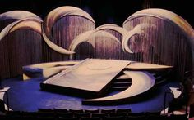
Shape in Theatre
Affected by size and shape of theatre
Must take into account how all the pieces work together

Slide 7
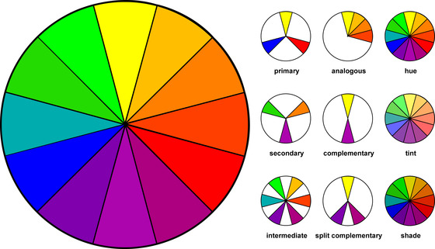
Color
Definition:
Used alone, as a background or applied to other elements
Creates a mood with colors having different meaning
Combinations create different visual affects = Color schemes

Slide 8
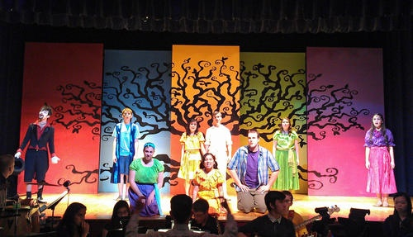
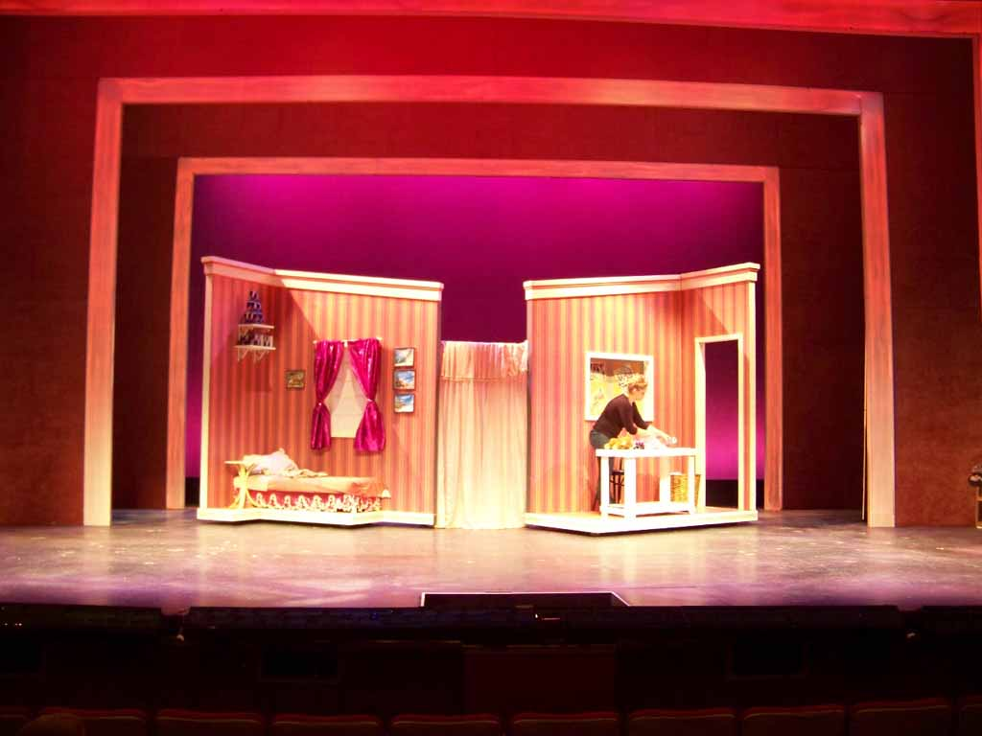
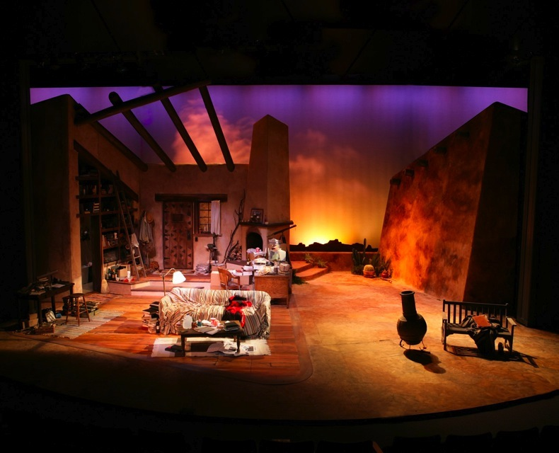
Color in Theatre
Lights, Sets and Costumes must work together as a cohesive entity

Slide 9
What type of set is it? Which element is strongest?

Slide 10
What type of set is it? Which element is strongest?

Slide 11
What type of set is it? Which element is strongest?

