Slide 1
1/21: Warm Up = What type of set is pictured below? How do you know that?

Slide 2
Daily Learning Target:
SWBAT differentiate the different elements of design and analyze how this applies to theatrical scenery.
Elements of Design:
Line
Shape
Color
Texture
Space
Proportion

Slide 3
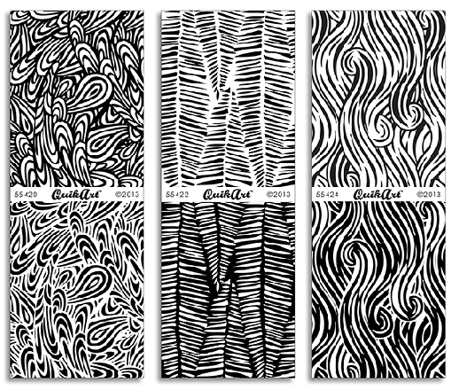
Texture
Definition:
Though the design is 2-Dimensional and will not be touched, texture (even the appearance of texture) is just as important
Creates depth on the page
Appearance of a three-dimensional image

Slide 4
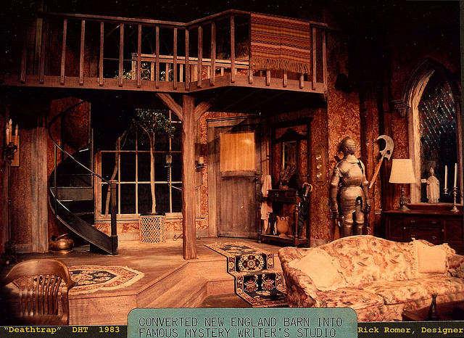
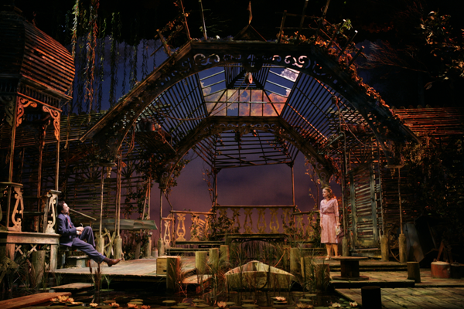
Texture in the Theatre World
Texture is used to create depth on stage
Prevents everything from looking flat (Lights flatten out everything)

Slide 5
Space
Definition:
Negative space (the space not being used) is just as important as the space actually used
Blank area (usually white but can be another color) are important to create the overall image

Slide 6
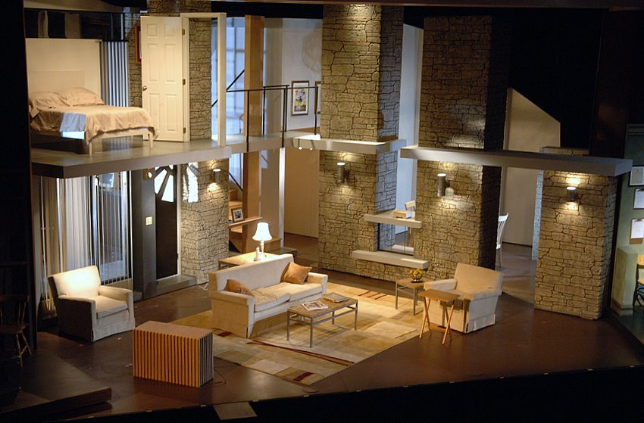
Space in Theatre
Just important how the stage is used as well as how the space is filled
Aka not putting a huge set in a small theatre or a tiny set in a huge theatre

Slide 7
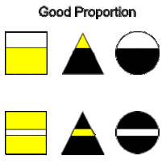
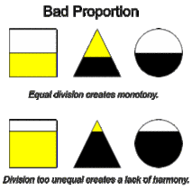
Proportion/Scale
Definition:
Balancing the size/scale of the each part of the design
Varying the size of the elements
Sameness is boring
Often referred to as visual harmony

Slide 8
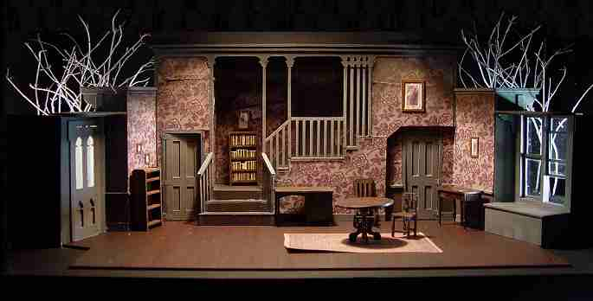
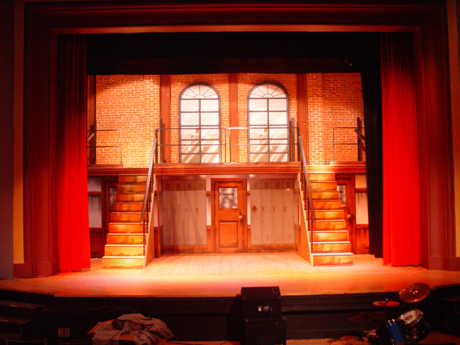
Proportion in Theatre
This is the balance of everything on stage
Do all elements work together in unison?
Does is create one cohesive look?

Slide 9
What type of set is it? Which element is strongest?

Slide 10
What type of set is it? Which element is strongest?

