Slide 1

1/22 or 1/23: Warm Up: What element of design is strongest below? Why?

Slide 2
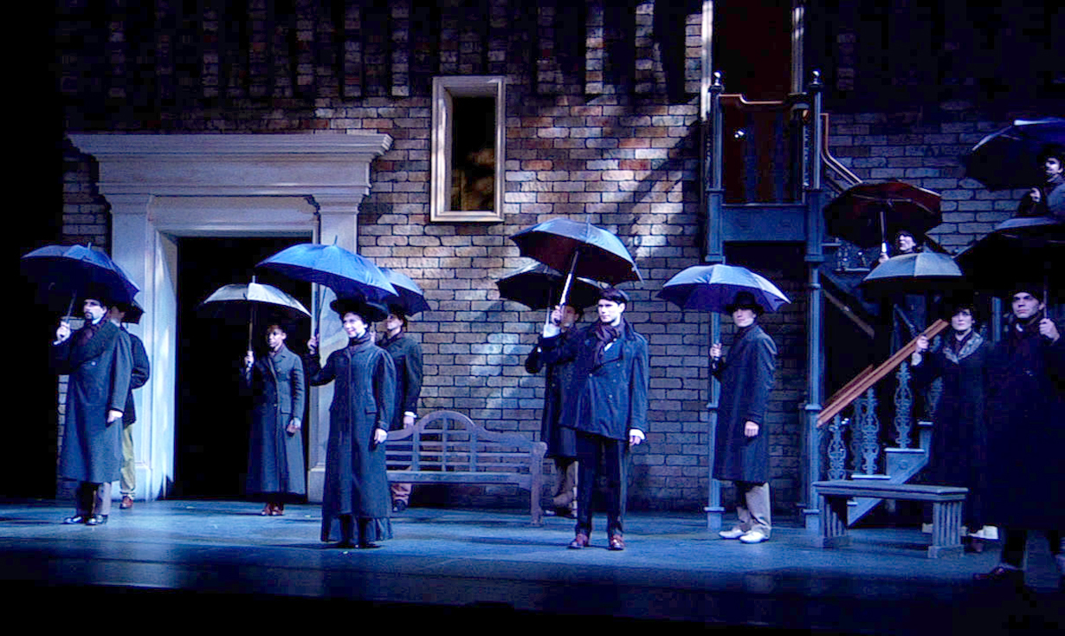
What type of set is it?
Which element is strongest?

Slide 3
Learning Target
SWBAT apply their knowledge of the elements of design to create a visual representation of their name using at least 2 elements.
  Line
  Shape
  Color
  Texture
  Space
  Proportion

Slide 4
Elements of Design Project
Due Friday January 30th
Choose at LEAST 2 of the 6 elements of design (in addition to color)
Create your name as block letters using those elements
Write a ½ response explaining:
  How you used those elements
  Why you chose those elements
  Did the final design end up working?
Requirements:
  White piece of paper
  Full page design
  Color must be used, as well as two others (a total of 3 elements)

Slide 5
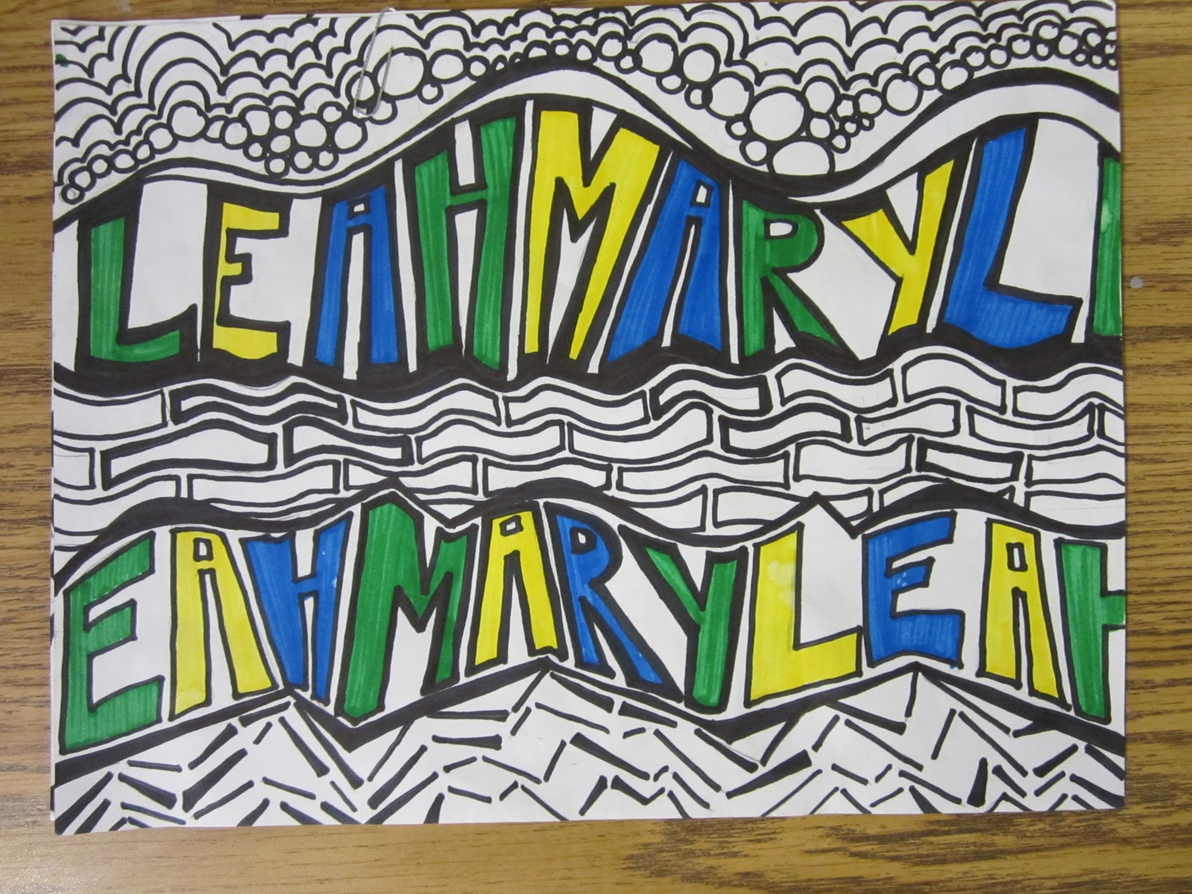
Here is an example using Line, Proportion and Color

Slide 6
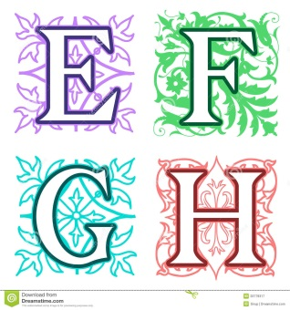
This one uses line, space and color

Slide 7

This one uses all 6

