Slide 1
Final Tech Theatre Design Project
Fairytales and Disney

Slide 2
Fairy Tale Design Project
The ultimate finished product for this project will be:
A fully designed (sets, costumes, lights and sound) for a chosen fairytale or Disney story ex. Cinderella
An oral presentation to the class about your design

Slide 3
Grading
50 points Individual Grade – Did you do the job you were assigned to for the project?
50 points Group Grade – This is mainly the presentation – Did your group present? Did they present well?
10 Point Daily Grades for each day’s task – You need to complete the objective for the day or your group will lose points

Slide 4
Step by Step
Step 1: Form group between 3 and 4 people, no more than 4 can be in a group unless I give permission. NO ONE CAN WORK ALONE
Step 2: Choose a fairytale or Disney story to work with
Step 3: Choose a concept for your story – DO NOT REWRITE THE WHOLE STORY
For example: Cinderella set in a Private High School

Slide 5
Step by Step Cont’d
Step 4: Choose Jobs
Set Designer: Recommended to be the student who understands ground plans
Costume Designer: Recommended to be the student who can somewhat draw
Lighting Designer: Must have access to a colored printer
Sound Designer (Optional if the group is only 3 people): Recommended to be the person with access to lots of music

Slide 6
Step by Step Cont’d
Step 5: Begin brainstorming and sketching
Brainstorm with your group about how the set will look, what you want the costumes to resemble, color choices, etc. and begin sketching. KEEP ALL OF YOUR SKETCHES!
Step 6: RESEARCH
You must have visual research to support all design choices made.
For example: Pictures of real private HS uniforms vs. “movie” uniforms. Popular kids vs. “not”

Slide 7
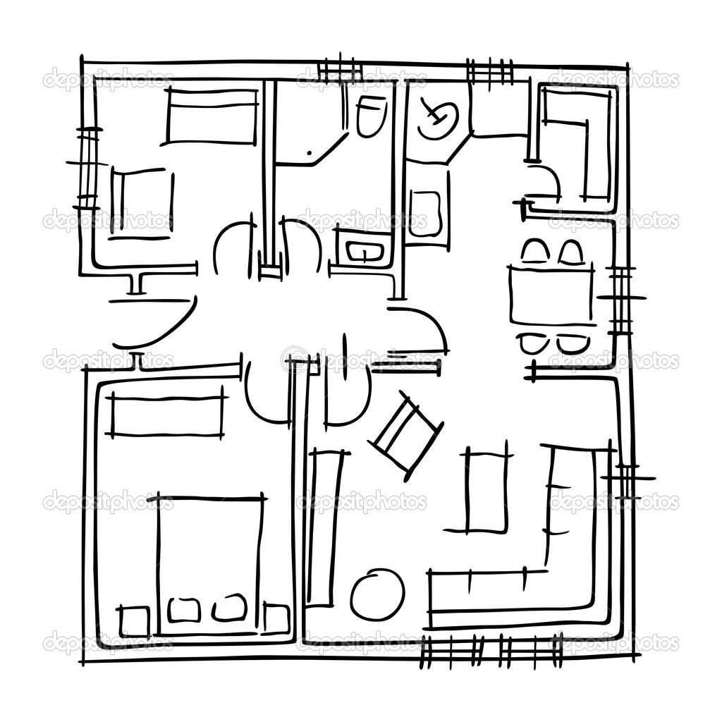
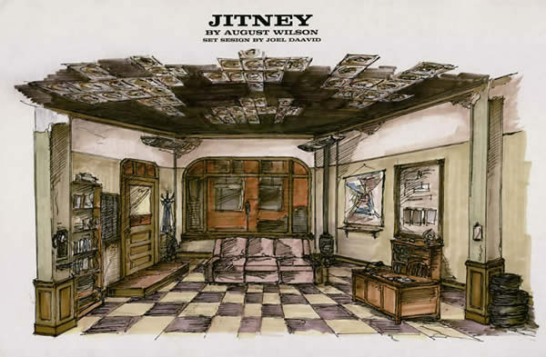
Step 7: Required Work
Set Designer:
Formal Ground plan(s) or set
Fully colored rendering(s) of set

Slide 8
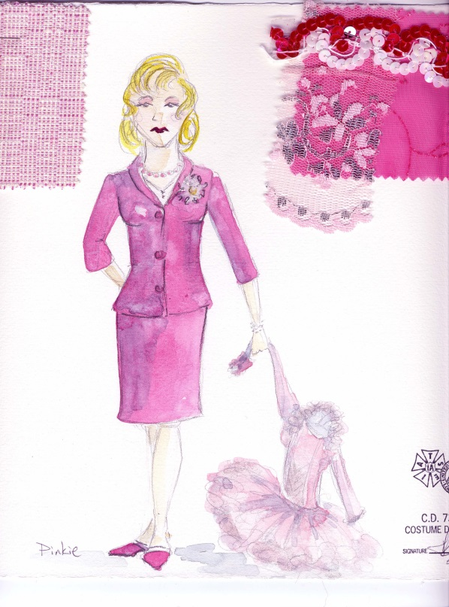
Step 7: Required Work
Costume Designer:
Full rendering of at least 2 characters with pictures or swatches of fabric

Slide 9
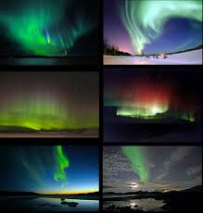
Step 7: Required Work
Lighting Designer
Lighting Concept
Lighting Sequence

Slide 10
Step 7: Required Work
Sound Designer:
Full soundtrack of at least 5 songs (cannot be the original movie song)
Minimum 5 sound effects

Slide 11
Step 8: Presentation
Each group will present their project in front of the class
Paper Presentation: +0%
Digital Presentation: +5%
Model Presenation: +10%

