Slide 1
How to Apply Color to A Set Design
Because whether you like color or not you need to use it on stage

Slide 2
So what does color tell us?
Location
Season/Time of Year
Mood
Theme
Vital Information
Year
Reality/Fantasy

Slide 3
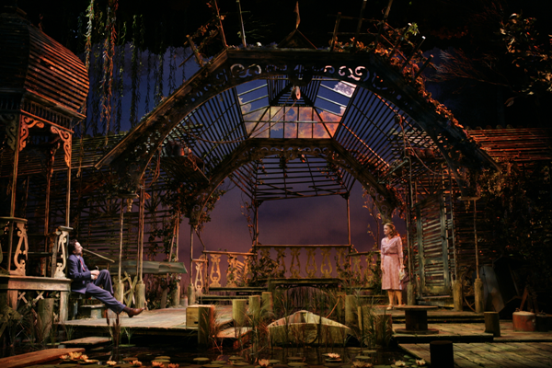
Location

Slide 4
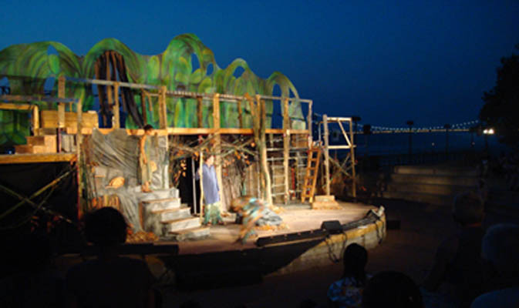
Season/Time of Year

Slide 5
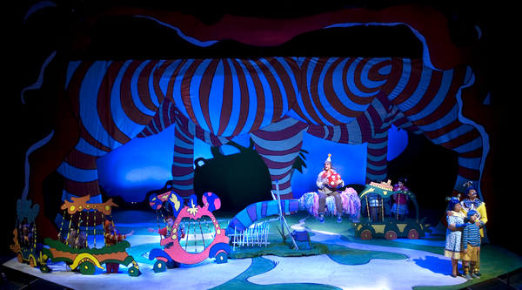
Mood

Slide 6
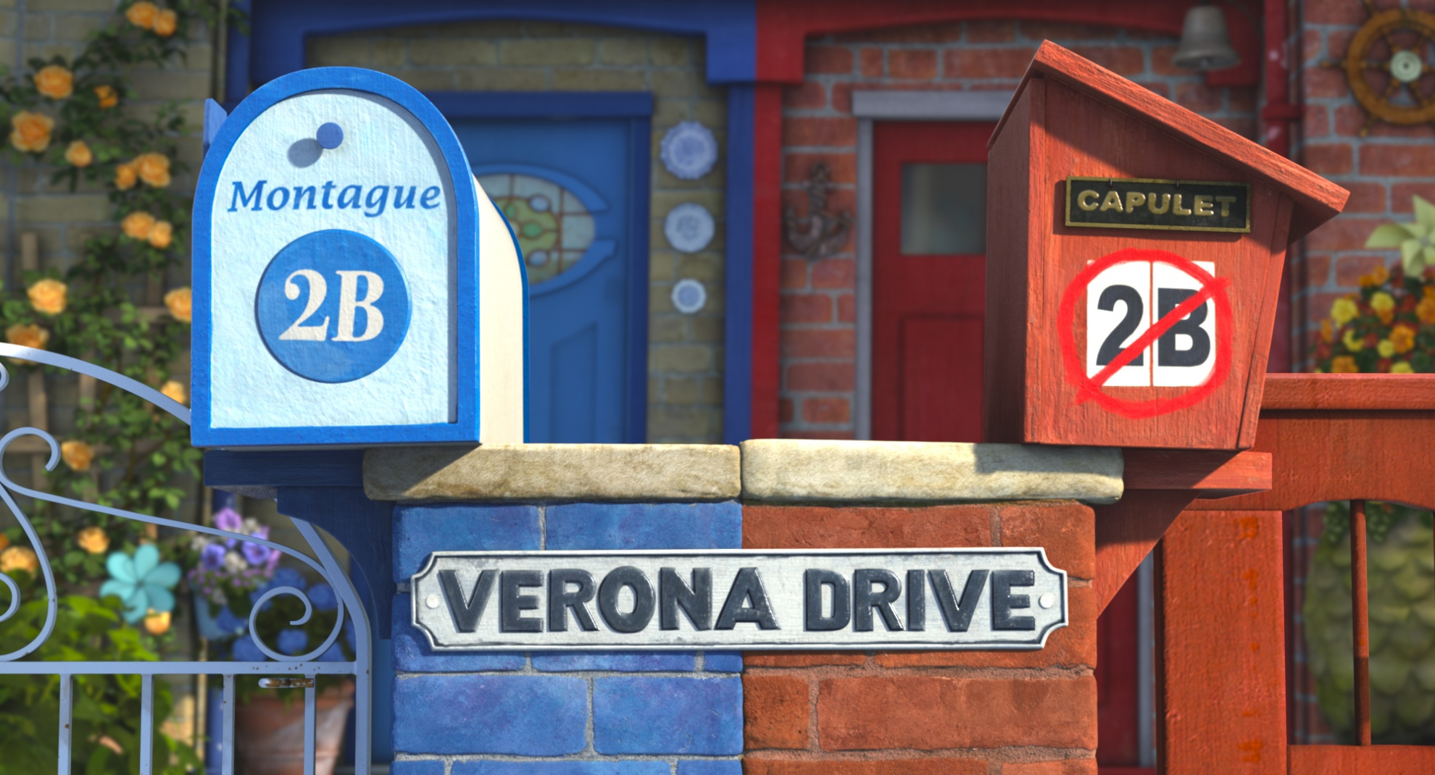
Theme

Slide 7
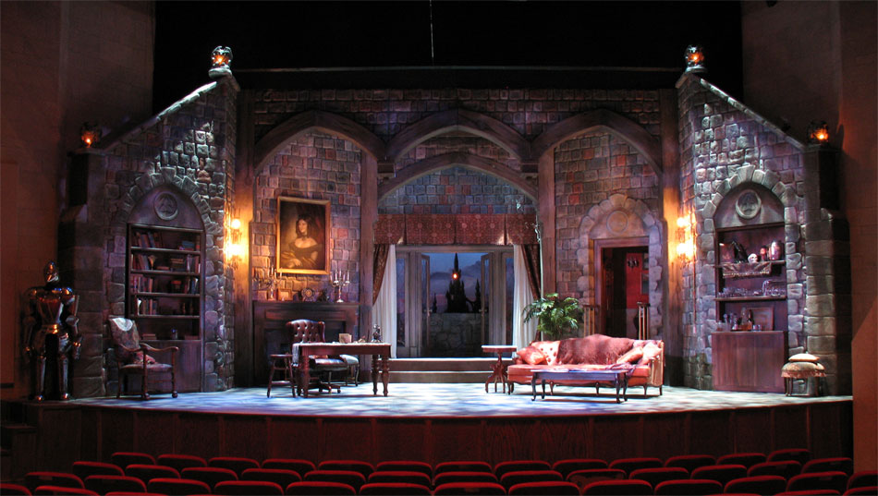
Year

Slide 8
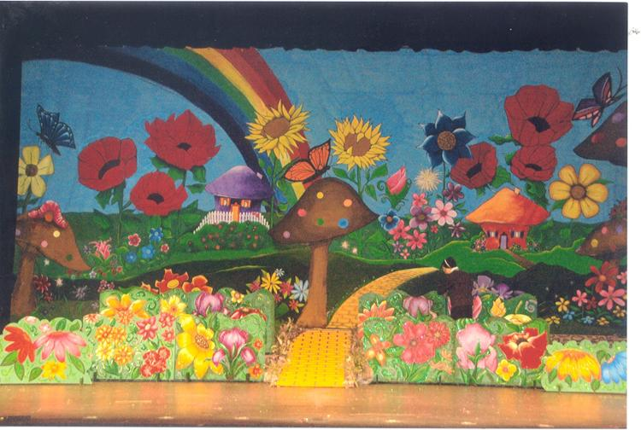
Reality/Fantasy

Slide 9
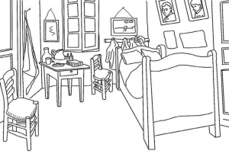
So now what are you going to do?
You are going to break into small groups
Each group will be given one of the 12 common character archetypes
As a group you will discuss that character and what you think his/her space would look like
You will then design and color the page
Lastly you will formally present your design to the class

