Slide 1
Color 101
Before color we must first understand how the eye work.
Warning this power point will make your brain hurt ☺

Slide 2
Stare at the black cross

Slide 3
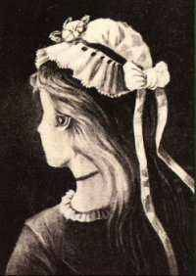
Young Lady or Old Woman?

Slide 4
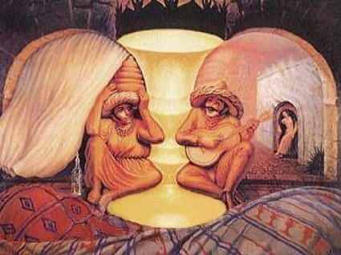
Old Couple or 2 Musicians and a lady?

Slide 5
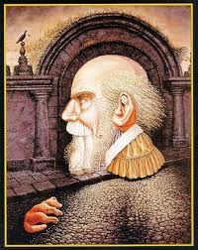
Old Man or a Woman and her Husband?

Slide 6
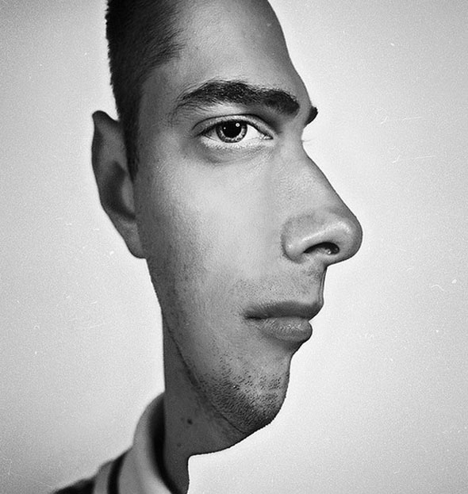
Which way is he facing?

Slide 7
Which way is the dancer spinning?

Slide 8
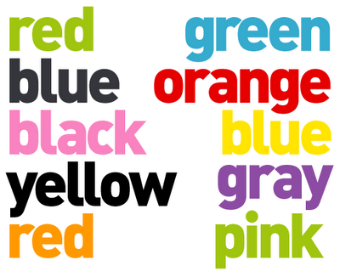
Say the color of the word, not the word itself.

Slide 9
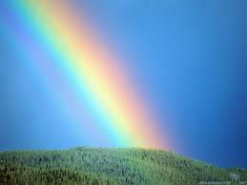
So what does that have to do with color?

Slide 10
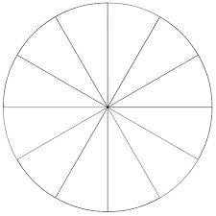
The Color Wheel

