Slide 1
Stage Lighting
Because you know who said let there be light…

Slide 2
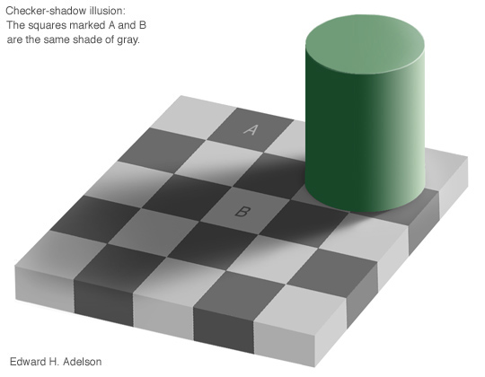
Time to Confuse you a Bit…
According to this image, Squares A and B are the same shade of gray.
True or False?

Slide 3
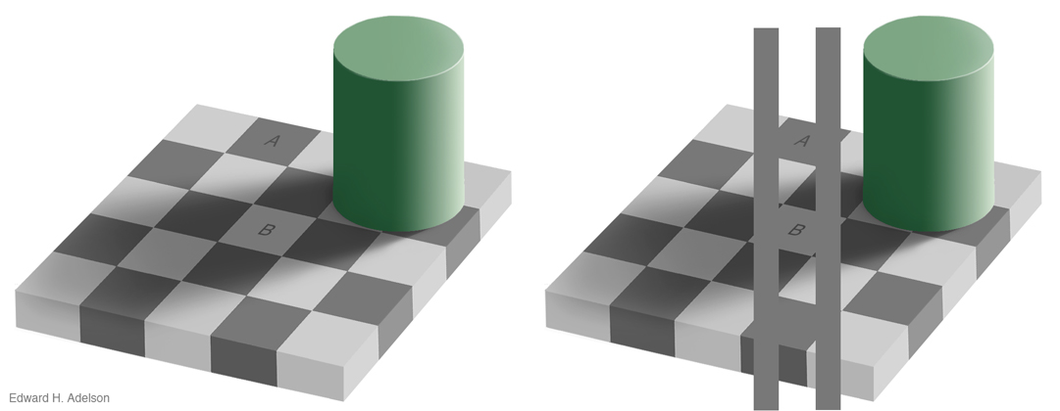
True
If you connect the two squares, you notice that the two shades of gray are exactly the same. ☺

Slide 4
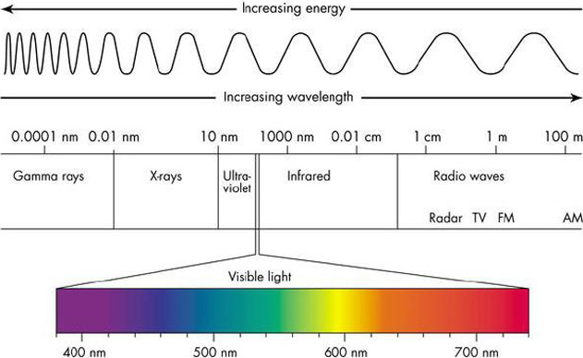
What is Light?

Slide 5
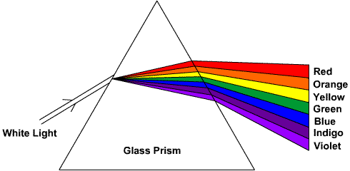
But how does WHITE light become multiple colors?

Slide 6
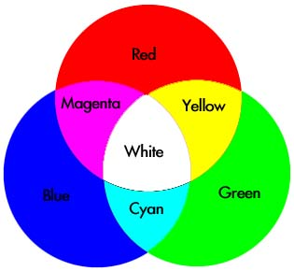
Primaries of Light
Primaries =
  Red, Blue and Green
Colors are Subtractive!

Slide 7
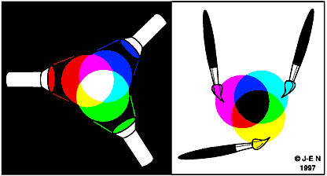
What does it mean to be subtractive?

Slide 8
So what does light do?
You can see the actors – since you are paying to see them
Hide something (scene change, character, really ugly wall, etc.)
Mood
Character
Ambience
Special Effects

Slide 9
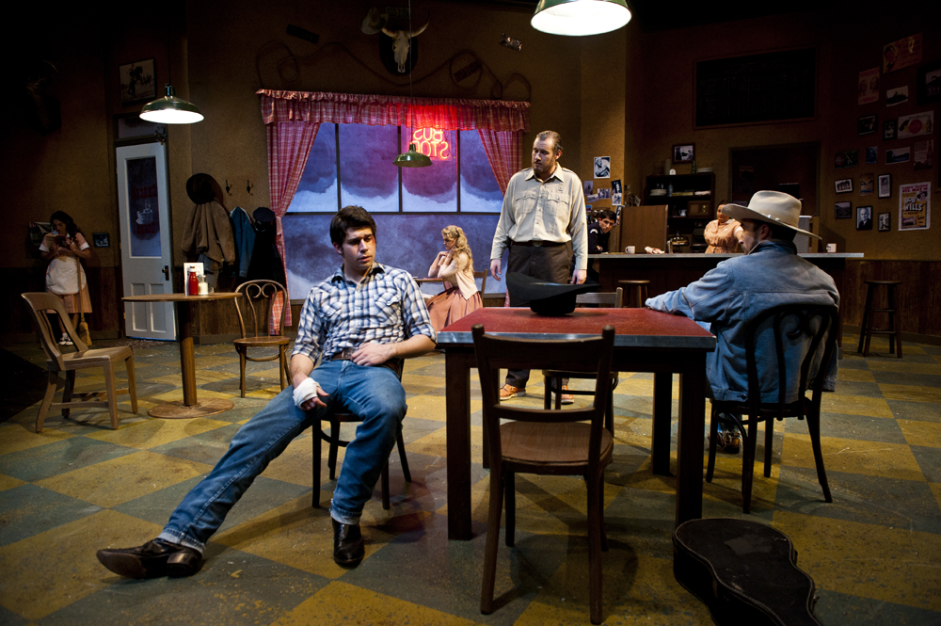
Natural Lighting

Slide 10
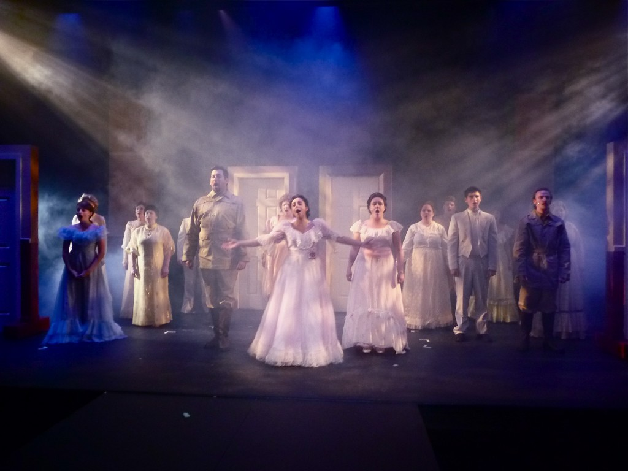
Dramatic Lighting

