Slide 1
Stage Lighting
Because you know who said let there be light…

Slide 2
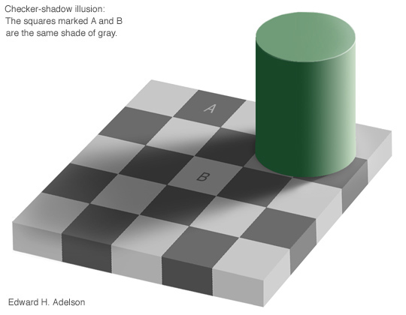
Warm Up:
According to this image, Squares A and B are the same shade of gray.
True or False?

Slide 3
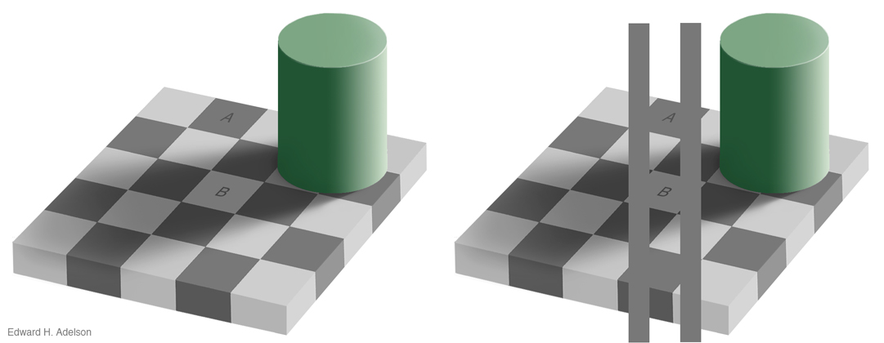
True
If you connect the two squares, you notice that the two shades of gray are exactly the same. ☺ This has to do with the shadow behind the cylinder and the relative light to each other.

Slide 4
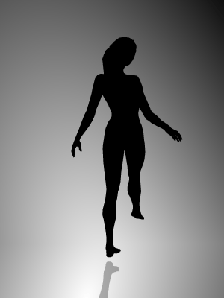
How about another one: Which way is the dancer spinning?
Can you get her to spin both ways?
According to science depending on which way you see her spin tells you which side of your brain in the dominate one (Creative vs. Logical)

Slide 5
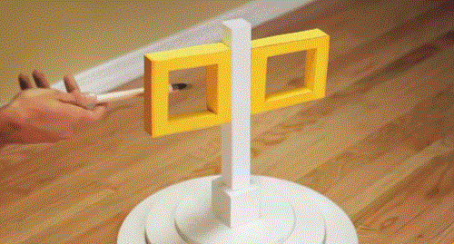
And one more.

Slide 6
Lighting Unit Target
Unit Target: SWBAT differentiate between the different: types, positions and purposes of light as demonstrated by designing a lighting sequence with pictures, fixtures and gel colors.
  Types of Light = there are different types of lighting fixtures for different tasks
  Positions = Where is the light coming from
  Purpose = Why are we using that light

Slide 7
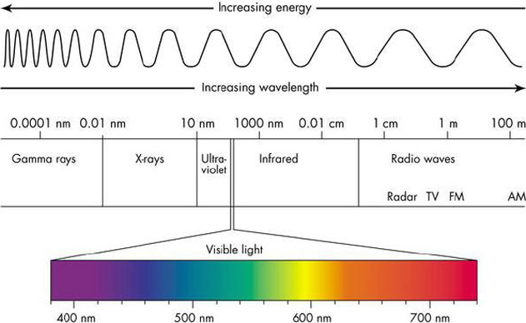
The Electromagnetic Spectrum

Slide 8

Visible light is the ONLY light we can see
Visible Light:
  Only light we can see
  Makes up a SMALL portion of the light spectrum (that’s the picture to the left)
  Red has a longer wavelength and less energy than Violet
  Each color has it’s own wavelength which is why we can see color.

Slide 9
Let’s listen to a little bit more about the electromagnetic spectrum
https://www.youtube.com/watch?v=m4t7gTmBK3g
MonkeySee Youtube Channel

Slide 10
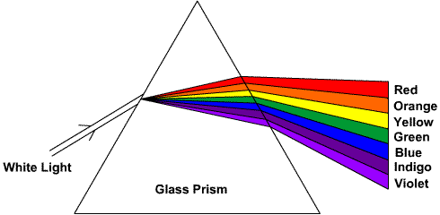
But how does WHITE light become multiple colors?
For my science geeks: To find the angle of spread you use Snell’s Law
When white light hits a prism (Or a cloud, glass, water, etc.) the different wavelengths spread because the change in the surrounding area.
ex. Think when one skateboard wheel goes off the sidewalk and the board whips around.

Slide 11
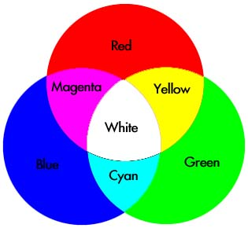
Primaries of Light
Primaries =
  Red, Blue and Green
Colors are Subtractive which means when you add all the colors of light together you get WHITE
When you add all of the colors of paint together you get black (Yes I know you get poo brown in real life)

Slide 12
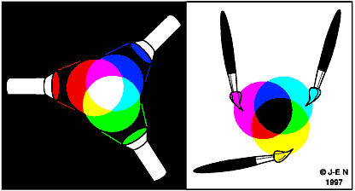
What does it mean to be subtractive?

Slide 13
Why do we need light on stage?
Write a list of five reasons why we need light on stage?
Compare with your table
Circle the one reason that you think is most important

Slide 14
So what does light do?
You can see the actors – since you are paying to see them
Hide something (scene change, character, really ugly wall, etc.)
Mood
Character
Ambience
Special Effects

Slide 15
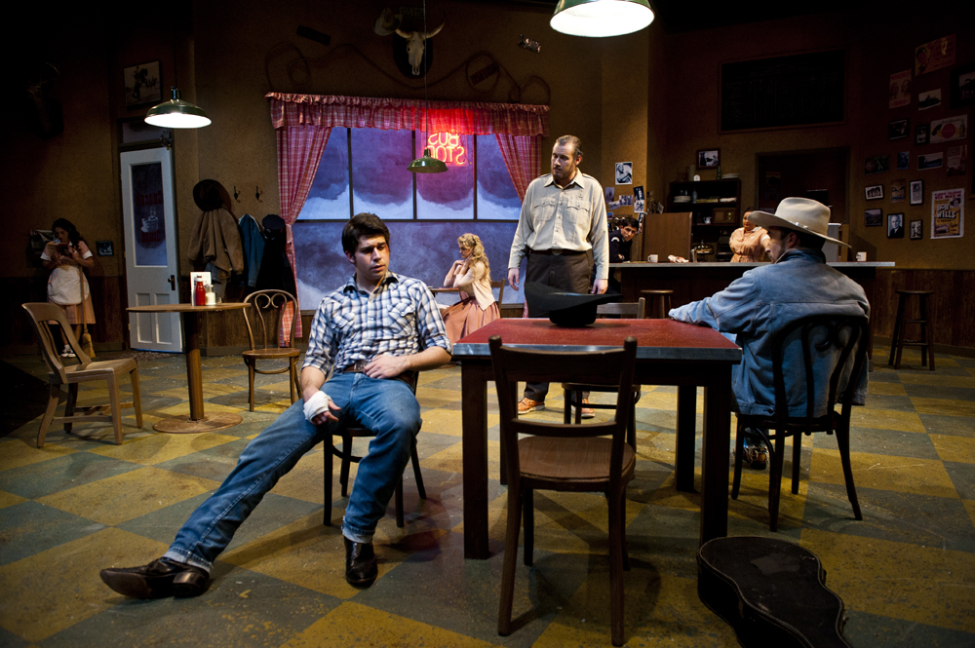
Natural Lighting

Slide 16
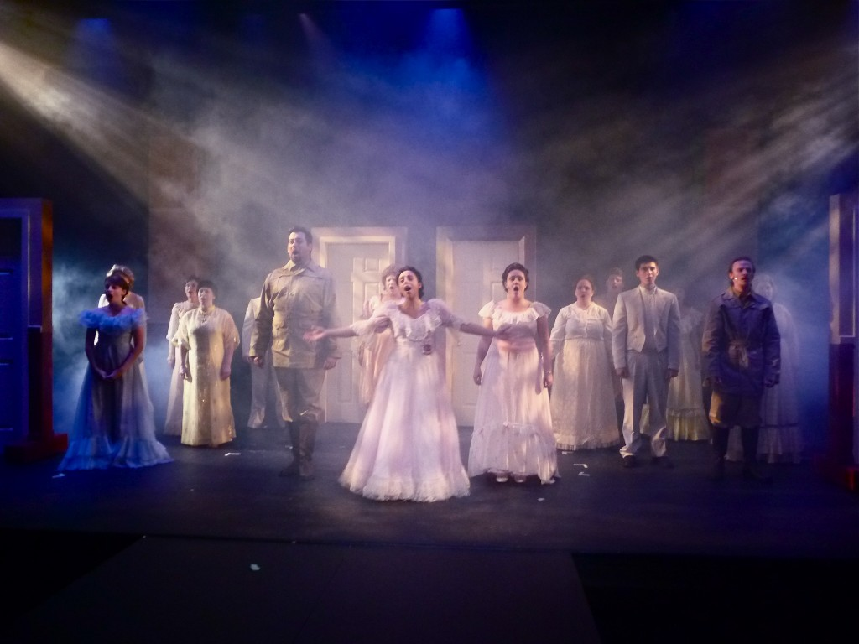
Dramatic Lighting

