Slide 1
Lacerations Warm Up: What can cause a laceration/cut?
Q.O.D: What is your favorite NON comedic movie?

Slide 2
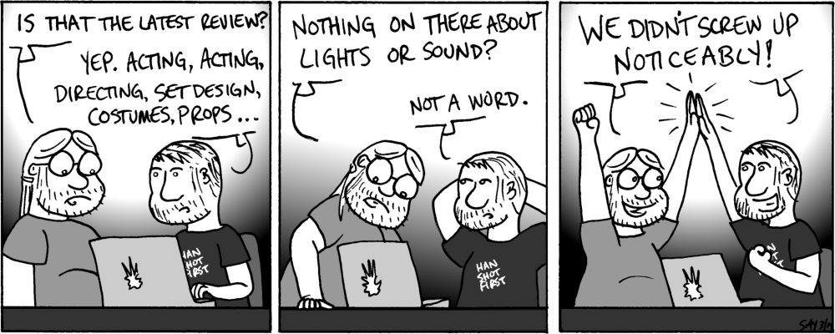
C.O.W.

Slide 3
Objective/Essential Questions
What causes lacerations?
How are they different?
How do you use the Ben Nye Gel Wound Kit to apply them?
By the end of class today we will answer these three questions

Slide 4
Lets talk about lacerations
Definition: a deep cut or tear in skin or flesh.
Differences:
Abrasion (scrape) – sections of skin are missing
Cut – skin is sliced open but not missing
Laceration – implies a torn or jagged (uneven) wound
Gash – a longer and deeper cut

Slide 5
How can you get a laceration?
How can you get a laceration?
Cut on something sharp (ex. A knife)
A punch/hit from a person or object (ex. A fist with rings)
Cut from an object flying past you (ex. Metal flying from a car crash)
Incision (opening from surgery) re-opening

Slide 6
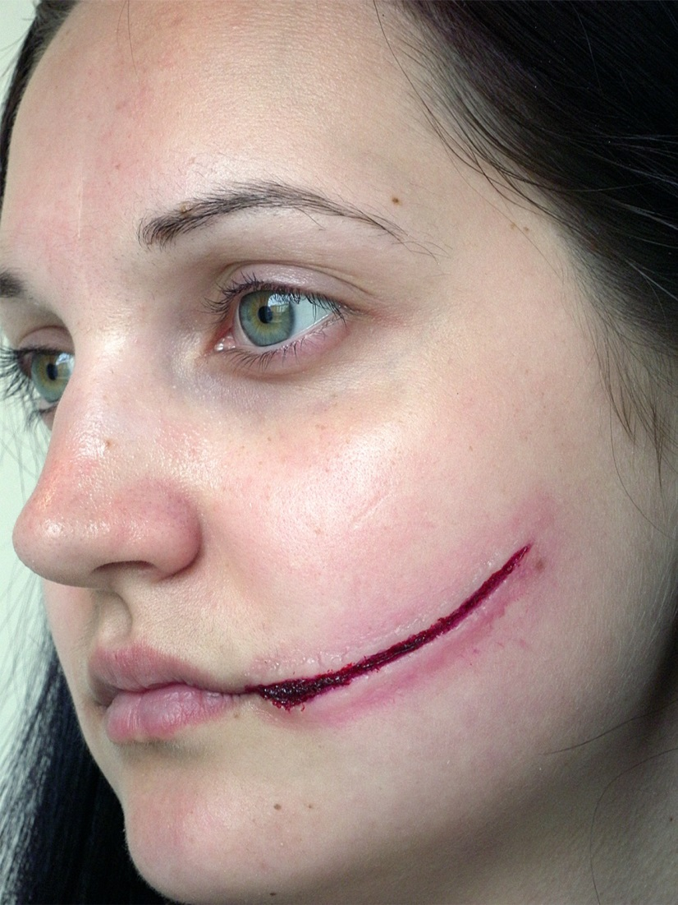
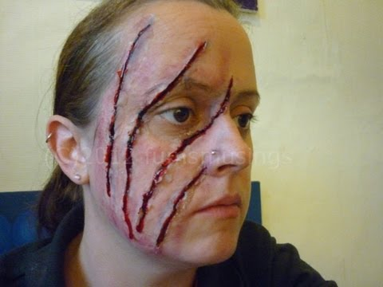
Why do they look different?
These are BOTH makeup
What is similar about them?
What is different?

Slide 7
Lacerations Look Different Because:
What caused the injury?
The person themselves
Where the injury occurred?
How old is the injury?
Underlining medical conditions

