Slide 1
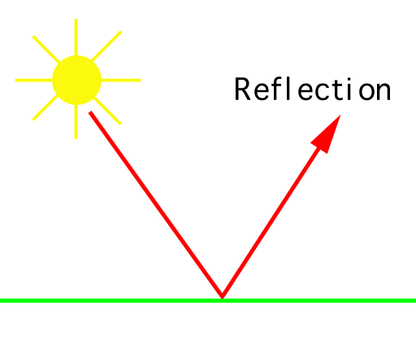
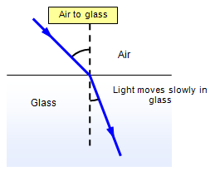
Warm Up : Given the pictures below; what is the difference between reflection and refraction

Slide 2
Objective
SWBAT discuss and analyze “What is Light?” and how does it act with its surroundings
Think about yourself?
Does your mood changed based on your surroundings?
Do you act differently around different people?

Slide 3
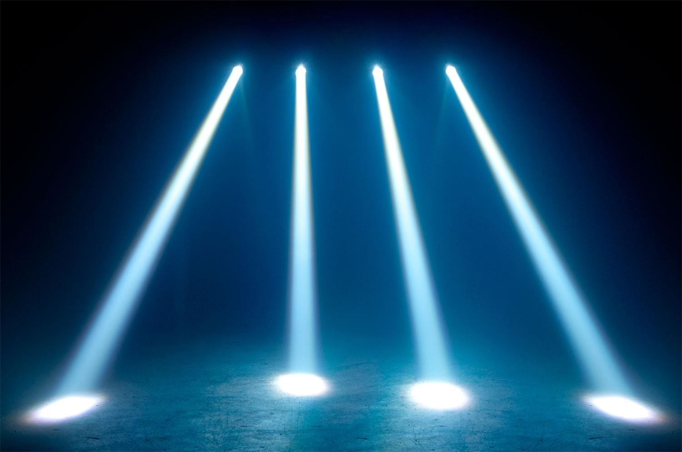
Light
Travels in a straight line
Beams can be drawn with a line
Cannot travel through opaque objects (like you or the wall)

Slide 4
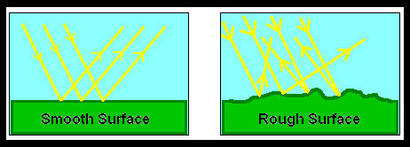
Reflection
Light bouncing off a surface and back to our eyes
All objects reflect light (some more than others)
Smooth surface reflect in an orderly pattern while rough surfaces diffuse (spread out) the light

Slide 5
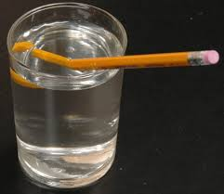
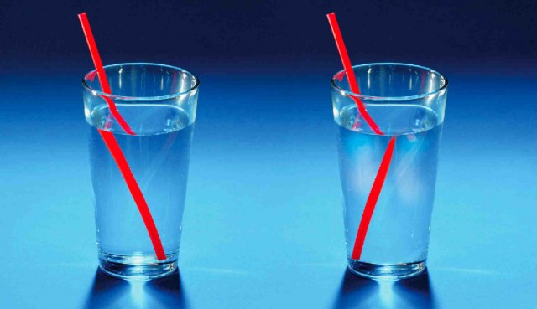
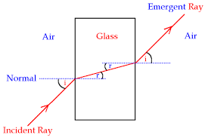
Refraction
The bending of a light wave when it enters a new medium (environment)
The larger the difference between the two environments, the greater the bend

Slide 6
Review: Answer these questions
Name an object that reflects all the light that is shown on it?
Can you calculate where the light will bounce off a smooth reflective surface?
Name one activity made more difficult because of refraction (hint…think water):
What is the relationship between refraction and the rainbow?

Slide 7
A little more review on What is Light?
https://www.youtube.com/watch?v=50B8ErvdElI
And some fun experiments with reflection and refraction:
https://www.youtube.com/watch?v=gDA_nDXM-ck

