Slide 1
Liquid latex Warm up: What was the hardest part of the old age makeup?
Obj/Eqs: What is liquid latex and how can we use it?

Slide 2
Old Age Makeup
http://www.youtube.com/watch?v=GaygHzXvIWo
Tricks = Highlight and contour
You can use liquid latex to look old
http://www.beautylish.com/a/vcnrv/halloween-aging-makeup-tutorial

Slide 3
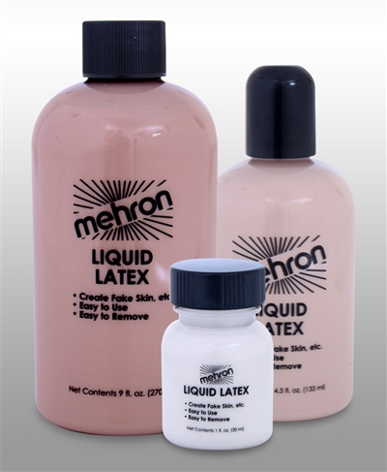
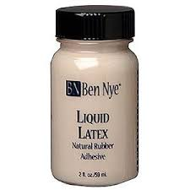
Liquid Latex
Think liquid balloons
Commonly used in special effects makeup
Dries solid and fairly clear
STICKS TO ITSELF

Slide 4
Rules of Liquid Latex
Liquid latex does not hurt, sting, prick or itch if you prepared your skin properly. If in any case it does, that means you're allergic to it and should stop. (Allergic = Don’t use)
You HAVE TO properly vent out liquid latex before using it. Shake the bottle well and keep it open for 5-10 minutes so it can vent out the ammonia. If you're using liquid latex in larger containers, just pour some in a plastic cup and let it breathe for a while before using. it would also help to stir the liquid latex in the process. (Vent Latex)
Do not apply liquid latex on any type of wound, acne or irritated skin. (Not on irritated skin)
Liquid latex and hair are enemies. shave or wax. unless you want to get hurt. (SHAVE!)
Latex like most paint, is highly flammable. (Don’t go near an open flame)
While working with liquid latex, do not use any container or mixing sticks that you will use in the future for your food. (NOT EDIBLE!)
Keep it away from children. (Or sometimes high schoolers)

Slide 5
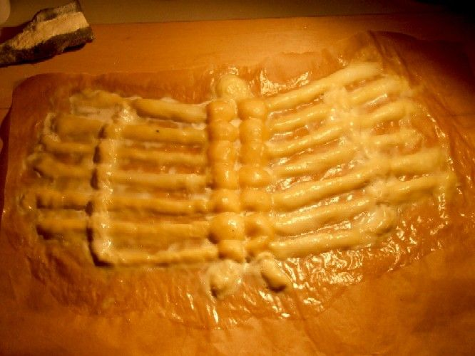
Latex Prosthetics
How do you think this was created?
What materials were used?
http://www.instructables.com/id/Effective-prosthetics-for-your-YouTube-videos/?ALLSTEPS

Slide 6
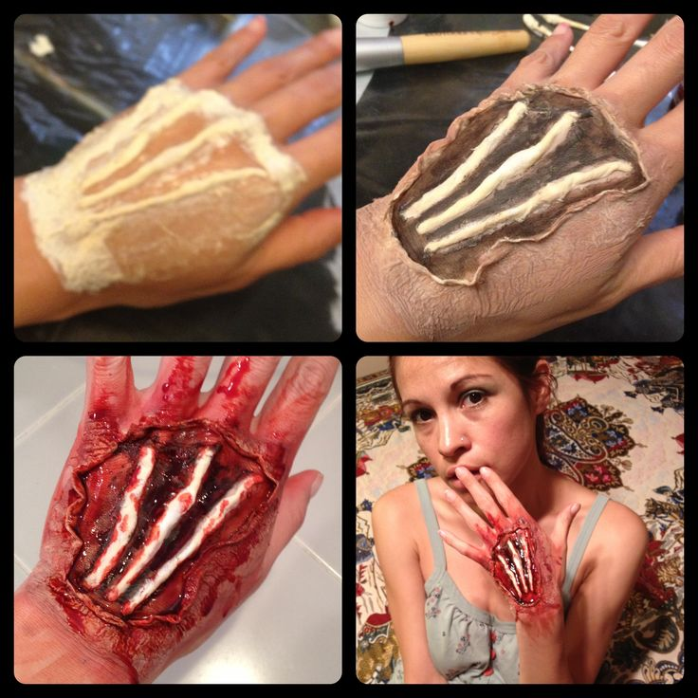
It can be used to create fake bones or tendons
Each step is layered on and painted for depth
Scar wax is used to create peeled skin

Slide 7
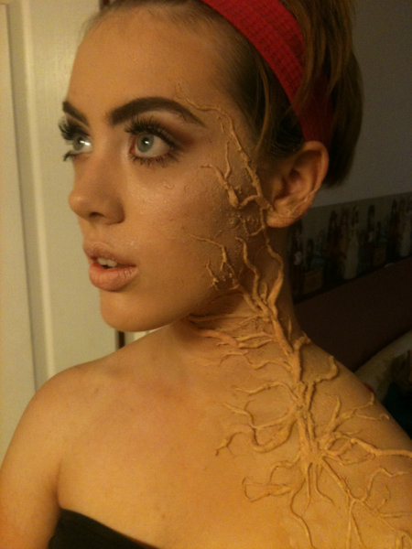
Raised “veins/branches/scars”
How do we think this was created?
What steps need to be taken?
Knowing what we know about liquid latex what would you have to pay attention for?
What can be done to take this one step further?
http://www.youtube.com/watch?v=-G0vy7vhlfA

