Slide 1
Makeup – New Unit
Learning Target = SWBAT research, design and create their own zombie characters

Slide 2
Why Makeup?
Why does everyone wear makeup on stage?
Stage lights wash out an actors features, it flattens them, so adding makeup adds depth to an actors face
Actors sweat under stage light, then the light would reflect off that sweat and no one likes a shiny actor
Basic stage makeup = cake makeup
Includes:
Foundation
Concealer
Blush
Highlight and Contour
Eye Liner
Lip Color
Eye Color as needed

Slide 3
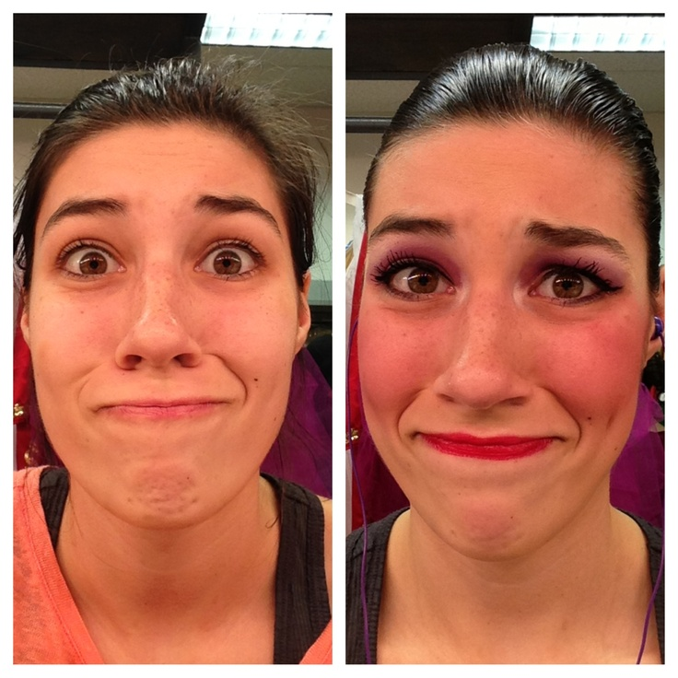
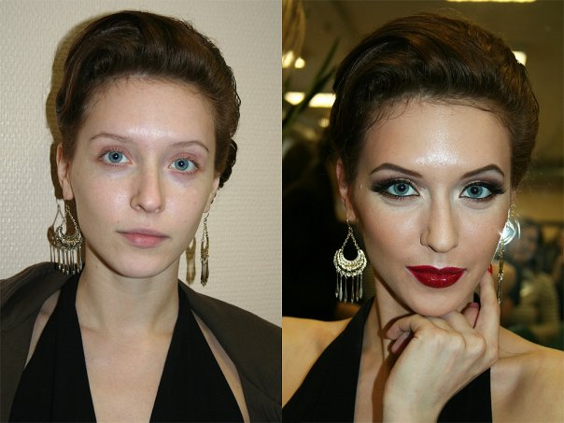
Stage Makeup is More Exaggerated

Slide 4
Steps for Men’s Makeup
1. Wear a button up or zip up shirt
2. Clean shaven and clean face
3. Moisturize your face
4. Apply foundation – As close to your skin tone as possible (can go darker for a proscenium shade) *Less is more*
5. Contour natural shadows on your face *Contour Down
6. For every contour there should be a highlight *Highlight up
7. Blush on the apple of your cheek to hair line *Fish Face*
8. Eye Liner – Brown tones, both on eye lid and under lashes
9. Lip color – natural colors
10. Set with powder all over.

Slide 5
Steps to men’s makeup
1. Wear a button up or zippered shirt
2. Clean shaven and clean face
3. Moisturizer
4. Apply foundation – skin toned or one shade darker *less is more
5. Contour face – blend down – use natural shape of face
6. For every contour there should be a highlight – blend up
7. Blush – apples of your cheeks to your hair line *Fish face*
8. Eye Liner – brown – upper lid and under lower lashes
9. Lip Color – Natural tones
10. Set with powder

Slide 6
Now what do you need?
Cleanser
Moisturizer
Primer (optional depends on foundation)
Foundation
Concealer
Contour
Highlight
Setting Powder
Eye Liner
Blush
Lip Color
Eye Color = Optional
Mascara or fake eye lashes
Eye Shadow

