Slide 1
Warm Up: 3/11 Name one thing you learned in the theatre the last 2 Days
Obj: SWBAT differentiate between different parts of a light

Slide 2
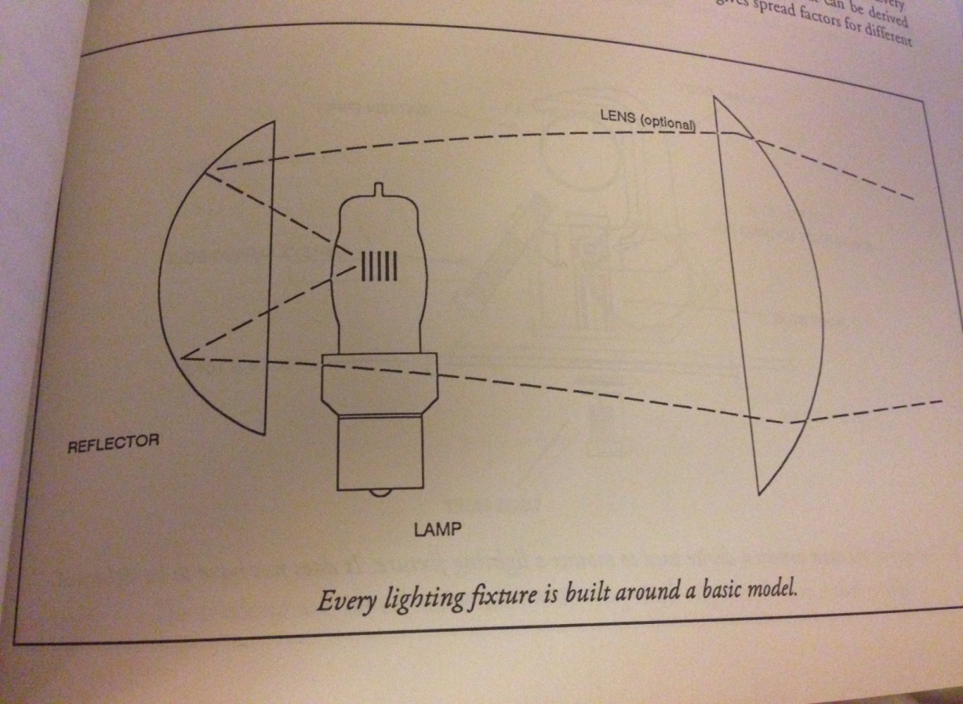
Parts of a Light
Every lighting fixture contains a lamp (bulb), reflector and sometimes a lens.
Parcans do not have a lens

Slide 3
Parts of a Lighting Fixture
Lamp Housing – Back of fixture that holds the lamp (the bulb)
C-Clamp – Metal bracket that holds the fixture to the pipe or batten
Yoke – U-Shaped bracket which connects the C-Clamp to the fixture
Safety Cable – Goes around the fixture and the pipe as a back up
Shutter Handle – Controls the shutters to change the shape of the light
Power Cable - What you plug in
Gel Frame Holder – Holds the gel which creates the color

Slide 4
C – Clamp Close Up
Crescent wrenches are used to tighten or loosen all the bolts around a fixture.
The ½ Bolt under the yoke is called the “Jesus” nut
NEVER loosen the “Jesus Nut” to rotate the fixture
To rotate fixture use the Pivot Locking Bolt

Slide 5
Ways of Hanging Lights
Batten – Standard lighting pipe (also known as Electrics if they have electricity run through them)
Ladder – Hung from the ceiling or a batten they hang down and are often used for side light
Tormentors – Are hung off a wall (Sometimes called Booms)
Booms – Are a free standing pipe with a waited bottom (Sometimes called trees)
Stands – An area to rest a light with a waited bottom

Slide 6
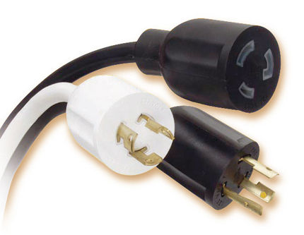
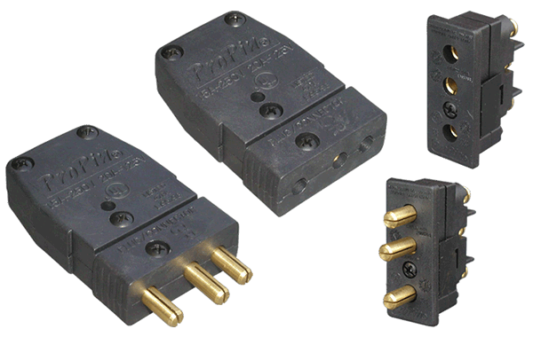
Types of Plugs
Twist Lock – plug is twisted to secure. What we have here
Edison – standard wall plug
Stage Pin – Three prongs

Slide 7
Safety and Handling Rules
Always use gloves
Fixtures get hot so the gloves protect your hands from the heat
Stronger grip
Keeps your hands clean

Slide 8
Safety and Handling Rules
Never NEVER touch the lamp (bulb) by the glass
Oils on your hands transfer to the lamp
Oil heats up hotter than the surface of the lamp
Creates a weak point on the lamp so the lamp would go “boom” and explode

Slide 9
Safety and Handling Rules
Always attach the safety cable first
Safety cables are rated for a few hundred pounds
Back up device to catch lamp from falling if improperly hung
Source 4’s weight 14 pounds + landing on your head = Dead

Slide 10
Safety and Handling Rules
Always secure your wrench to your belt/pants
Wrench is always within arms reach
If you drop the wrench it won’t fall therefore causing:
You to have to go get it
Landing on a set piece breaking it
Landing on a person and breaking them

Slide 11
Safety and Handling Rules
Call out when “Going Dark” aka turning off lights
Gives everyone on stage a heads up that the lights are turning off
Also call things like:
Flys coming in or out
Electrics coming in or out
Loud Noises

Slide 12
Price Break Down
The fixtures to the left are standard ERS lights from two different companies
These are the same Source 4 ERS, but as LED Source 4s…note they are about 10 times more expensive

Slide 13
Fresnels, Parcans and Source 4 Pars:

Slide 14
And for fun…

