Slide 1
Parts of a Stage

Slide 2
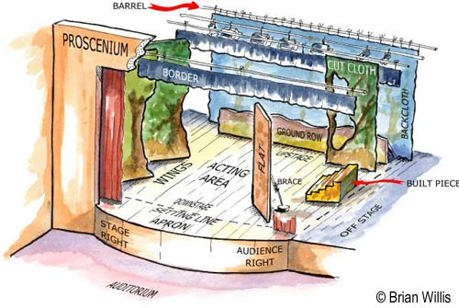
Please Draw and Label This ☺

Slide 3
Parts and Definitions
Wings: The space immediately off stage left and right (Think a bird’s wings are immediately to their side)
Proscenium Arch: The arch in the front of a proscenium stage that creates a “picture frame”
Apron: The space immediately down stage of the proscenium arch

Slide 4
Parts Continued
Borders: Short curtains that create a visual border around the stage (think my Christmas lights create a border around my white board)
Flat: A Hard (or soft) wall of scenery. This comes in various sizes (It can also contain a door or window)
Background/Backdrop/Backcloth: The painted scenery of a set which is usually a large piece of fabric

Slide 5
Parts not labeled on diagram
Fly Rail: (In our theatre it’s off stage left) This is the system of counter weights that controls our fly system which brings curtains and set pieces onto the stage
Pit: The lower area in which the orchestra/band play during musicals
House: The audience
Electrics: Any pipe/baton hanging from the ceiling that contains electricity

