Slide 1
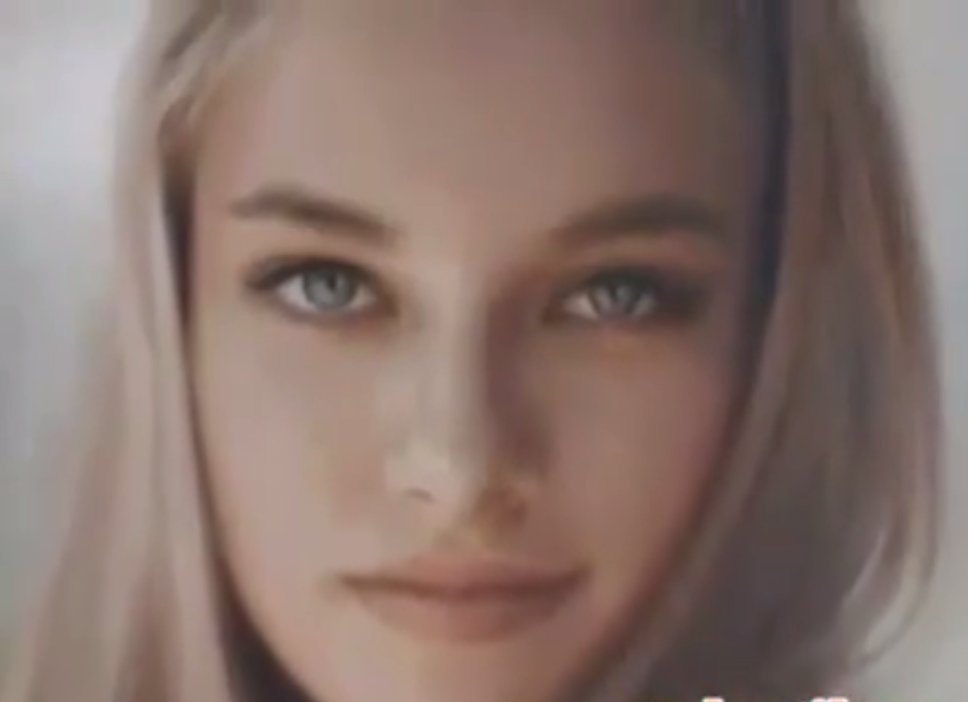
Scenic Painting: Is the image below a painting, a photo or a digitally created image?

Slide 2
For each Image: Painting? Photo? Digital Creation?

Slide 3
Painting? Photo? Digital Creation?

Slide 4
Painting? Photo? Digital Creation?

Slide 5
Painting? Photo? Digital Creation?

Slide 6
Painting? Photo? Digital Creation?

Slide 7
Painting? Photo? Digital Creation?

Slide 8
Painting? Photo? Digital Creation?

Slide 9
Painting? Photo? Digital Creation?

Slide 10
Painting? Photo? Digital Creation?

Slide 11
Obviously it was a painting….of my buddy Rob

Slide 12
Painting? Photo? Digital Creation?

Slide 13
So what can paint do for scenery

Slide 14
Detailed backdrops

Slide 15
This one is airbrushed

Slide 16
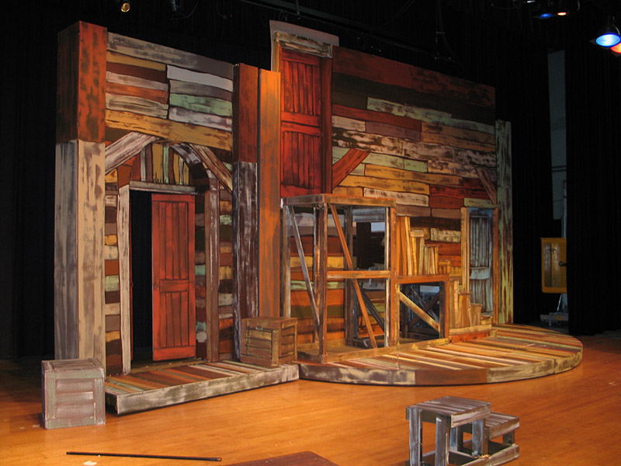
Wood grain

Slide 17
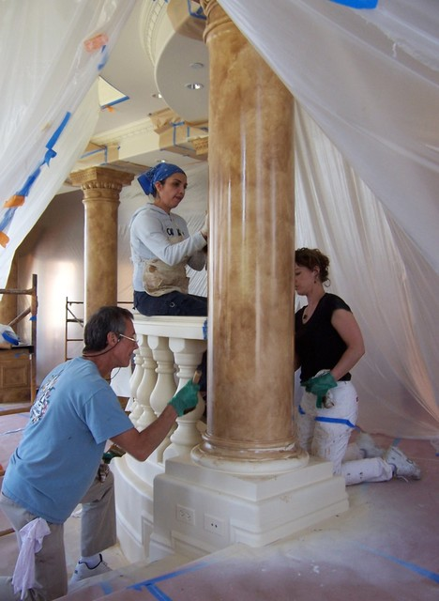
Marble

Slide 18
Scenic Painting Can Do Nearly Anything

Slide 19
Vocab Words
Highlight and shadow
Wet Blend
Depth
Splatter
Bristle Brushes
Foam Brushes

