Slide 1
Scenic painting vocab
Warm Up: Which painting technique is pictured below? How do you know?

Slide 2
Answer: Dry Brushing
Dry Brushing = 1. Either using a brush as dry as possible with little paint OR. 2. Using a dry brush to move paint around
Adds texture by creating brush strokes
Does not mix paint

Slide 3
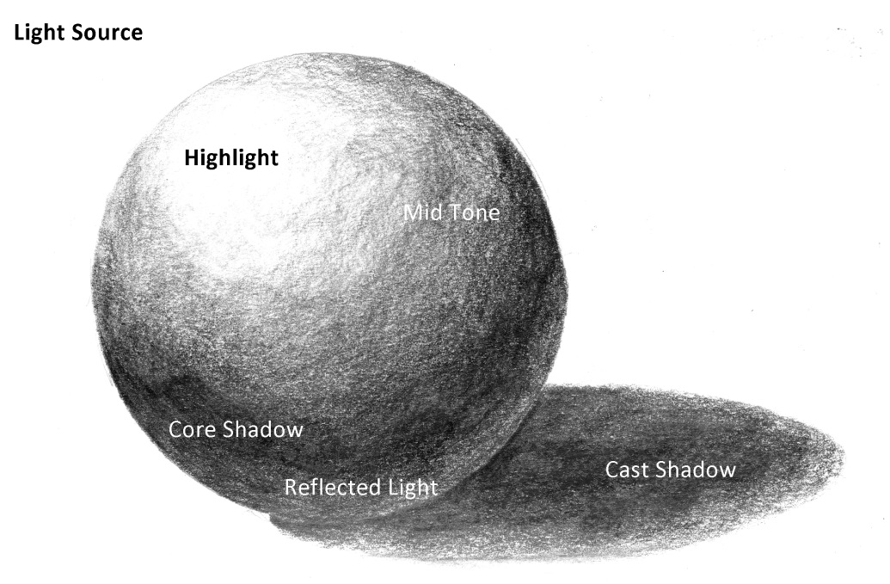
Highlight and Shadow
Value = The relative lightness or darkness of an object
Using highlight and shadows to create DEPTH makes objects look more realistic
Where is your light source?

Slide 4
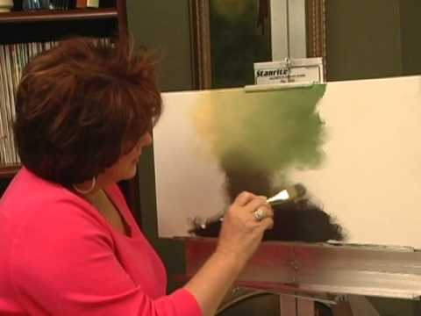
Wet Blending
When while paint is wet you layer paint colors side to side or sometimes on top of each other.
Think painting tie dyed. Not mixing colors
Base layer for MOST scenic painting techniques

Slide 5
Foam Brushes vs. Bristle Brushes
Foam Brushes:
Really really cheap
Break easily
Good for straight lines and covering larger spaces
Super cheap = basically disposal
Comes in various sizes based on inches
Bristle Brushes”
Made from different materials
Synthetic or natural
More expensive
Varies shapes = more applications
Only way to splatter paint

Slide 6
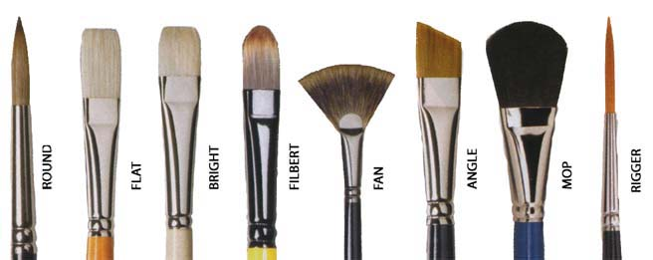
Bristles Continued
Synthetic vs. Bristle (Natural)
Synthetic:
Nylon/polyester brushes for latex,
acrylics, or water-based stains Bristle (Natural)
Bristle brushes for oil paints, oil stains, polyurethanes, or varnishes

Slide 7
Seussical Fish

Slide 8
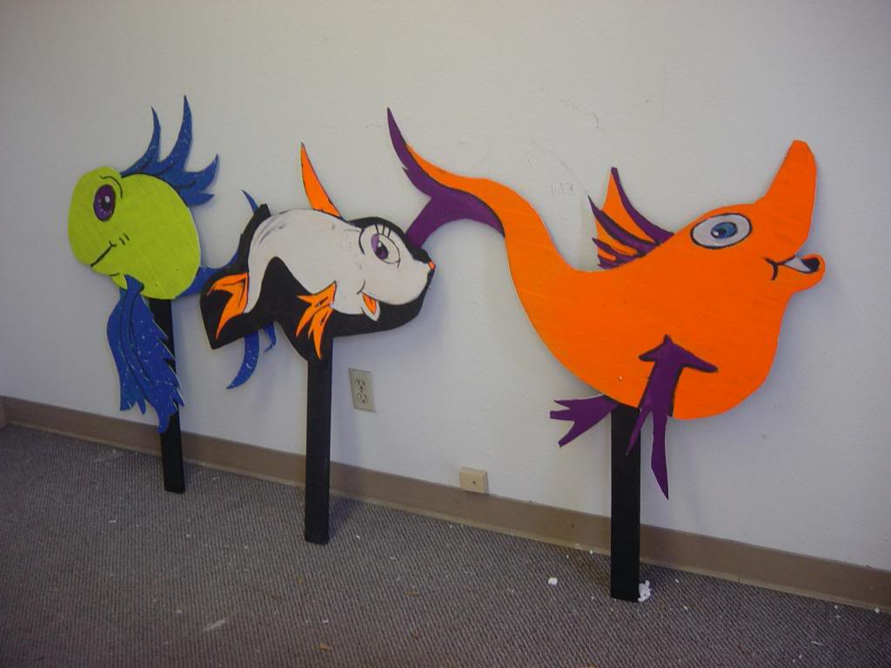
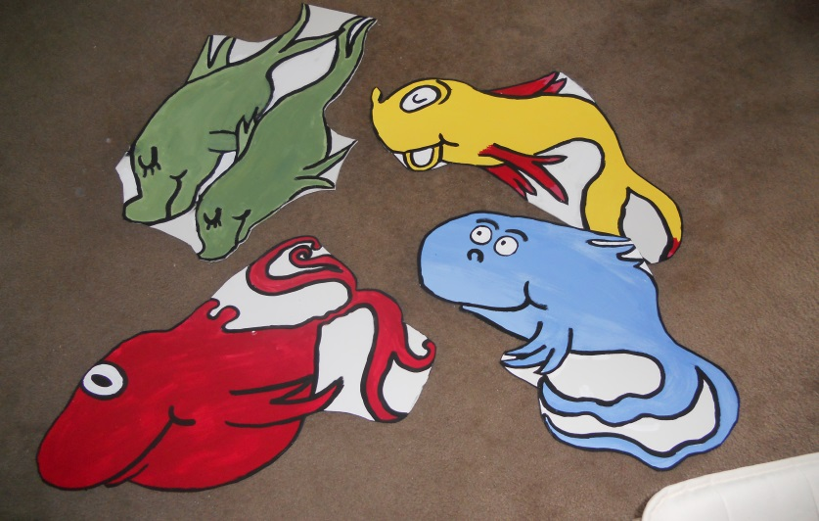
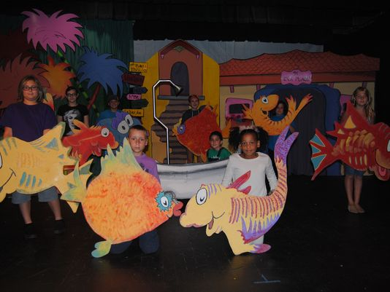
Seussical Fish
Think BIG BOLD BRIGHT and CARTOONY

