Slide 1
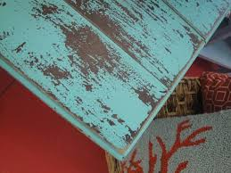
Scenic Painting Vocab Part 2
What painting technique is pictured below? How do you know that?

Slide 2
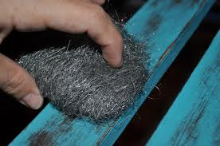
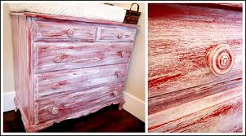
Answer: Distressing
Distressing = Purposely removing paint to make an item look aged or worn
Reasons to Do this: Style, Look, Necessity (You need an object to look old but you only have something brand new)
Ways: Sandpaper, Brillo pad, paint solvents

Slide 3
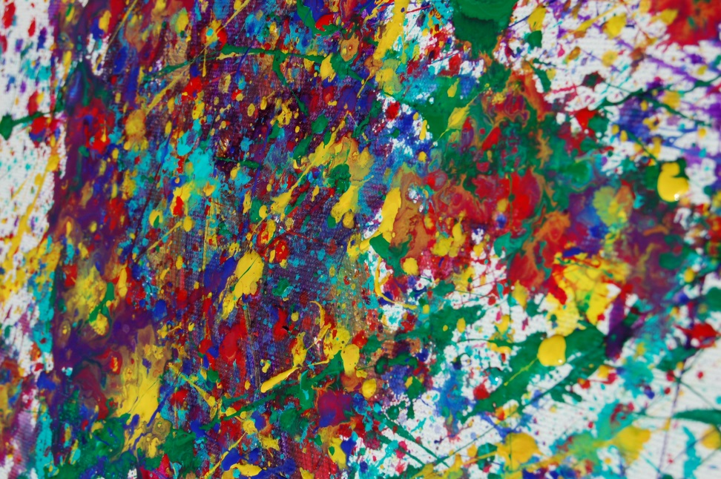
Splattering/Spattering
Splattering = Water (a small amount!) is mixed with paint and then using a bristle brush paint is thrown at the surface
Size of splatters depend on:
Amount of Water added
Size of Brush
Fling vs. Flick
How far away you are from your target
Used to add depth – Stage light catches the splatters and create texture making flat walls seem more realistic
Really fun…..REALLY MESSY

Slide 4
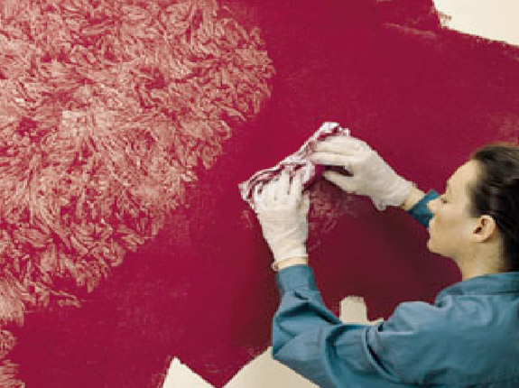
Rag Rolling
Rag Rolling = Can be done in two ways
Rolling on paint with a roller and then rolling a bunch of rag down the surface to remove paint OR 2. Rolling a rag dipped in paint on a surface
- Can create either a spontaneous pattern or one that is fairly uniform

Slide 5
Sponging
Sponging = Texture is created by sponging paint on to a surface or being removed from the surface with a (get this ☺) a sponge
Colors can be layered to create different effects
Different sponges with create different looks
One way to create granite (I like the splattering method better)

Slide 6
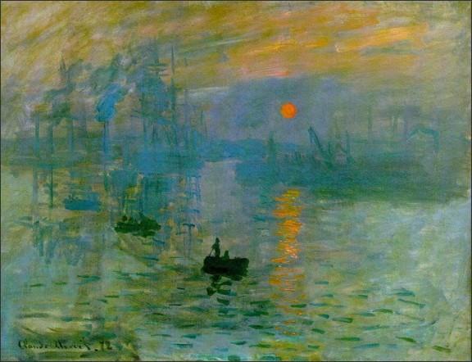
Scumbling
Scumbling = Putting a small amount of paint on your brush and then applying it lightly to a dry surface.
Often used to layer in the background ex. Sunbeams coming through the cloud
Think Monet

Slide 7
Bamboo
Bamboo = Bamboo is hollow and therefore a paint brush can be attached to the end of it to create an extension for the artist
Why? = Well usually you are painting with the set pieces on the floor and you can’t step on them and you don’t want to be hunched over. AKA Bamboo saves your back!
Comes in different lengths and widths.
No picture is needed….it’s bamboo.

Slide 8
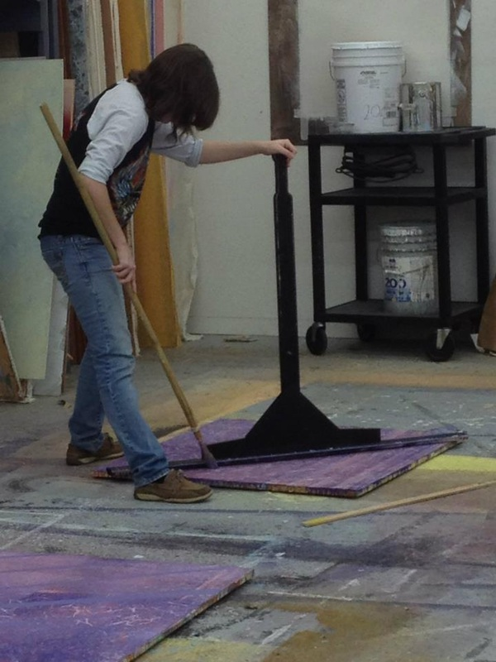
Lining Stick
Lining Stick = Used to create clean straight lines on the set piece
Long wooden piece connected to a handle
A paint well is cut out of the edge so that your painted line is clean
Oh look…Bamboo!

