Slide 1
Stage Blood

Slide 2
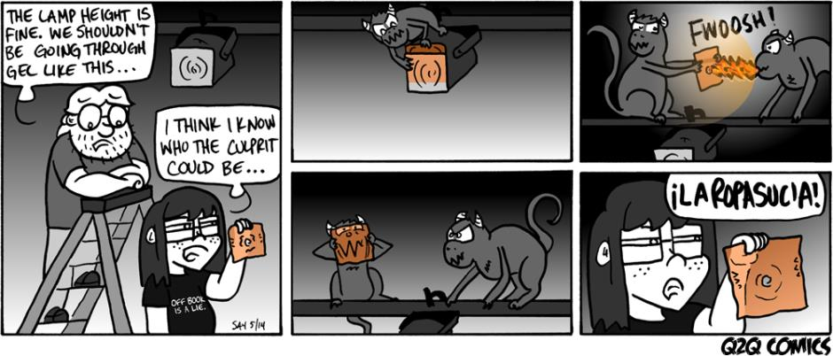
C.O.W

Slide 3
Recipe #1= Food Coloring + Water
Easiest Recipe
Cheapest
Quickest
Edible
Will Stain
Good for large batches
Good for fabric

Slide 4
Recipe #2 = Paint
Fewest ingredients (potentially if given the right shade of red)
NOT edible
Will stain
Good for small scale blood application

Slide 5
Recipe #3 – Chocolate Syrup
Classic black and white movie blood
Perfect consistency
Only good for “color” if you are taking a black and white photo or film

Slide 6
Recipe #4 – Detergent/Soap + Food Coloring
Will stain less than other recipes
Good for washing out of clothes
NOT edible

Slide 7
Recipe #5 – Corn Syrup + Coloring + Darkener + Thickener
This is the most traditional and flexible of blood recipes. It’s also edible
Coloring:
Food Coloring
Ketchup
Koolaid
Darkener:
Food Coloring
Chocolate Syrup
Maple Syrup
Thickener:
Corn Starch

Slide 8
Ms. Tobin’s Recipe
Corn Syrup
Koolaid
Red Food Coloring and ONE drop of blue
Thinner if needed
Edible
Sticky
Will stain
But very tasty

Slide 9
How to fix blood
Too thin – add thickener like Corn Starch
Too thick – add thinner like water or thin syrup
Too red – add a small amount of darkener like blue F.C or chocolate syrup
Too lumpy – keep mixing and thin as needed
Too dark/purple – Unless making a LARGE batch, throw this out and start again.

