Slide 1
Stagecraft Final Review
Draw a Line An Inch from the left margin. Write the notes on the right and ask questions on the left

Slide 2
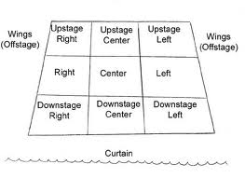
Stage Directions
From actors perspective
Downstage is CLOSER to the audience b/c stages used to be raked aka slanted up and away from the audience for sight lines

Slide 3
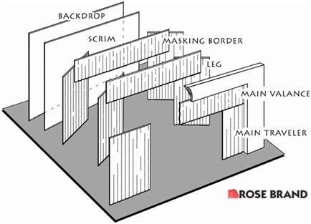
Parts of a stage
Traveler vs. Curtain
Traveler moves left and right
Curtain moves up and down

Slide 4
Parts of a stage…you should know
Border
Wings
Backdrop
Flat
Fly Rail

Slide 5
Types of stages
Proscenium
Black Box
Arena
Thrust
In the round
Amphitheatre
Traverse

Slide 6
Types of stages
You should be able to identify:
Name
What it looks like
Basic Pros
Basic Cons
For Example: Which type of stage creates a picture frame?
Answer: Proscenium

Slide 7
The Color Wheel
Primaries:
Red
Yellow
Blue
Secondaries:
Orange
Green
Violet/Purple
Tertiaries (Primary goes first):
Yellow-Orange
Red-Orange
Red-Violet
Blue-Violet
Blue-Green
Yellow-Green

Slide 8
Color Wheel
You should know:
How to fill in the color wheel
3 Primaries
3 Secondaries
6 Tertiary colors
Complementary colors
Blue-Orange (Thinks the Mets)
Yellow-Purple (Think the Lakers)
Red-Green (Think Christmas)

Slide 9
Color Wheel
As you move closer to the center of the circle, each color gets darker. It is the SAME color, but a different HUE
Hue = Shading from dark to light

Slide 10
Sets
You should know
Types of sets
Unit
Minimal
Prism
Box
Permanent
Curtain
Ground Plans
Set Vocab

Slide 11
Sets
Ground Plans
Eight Parts
Title
Walls/Furniture
Author/Designer
Revision # and Date
Orientation
Location
Scale
Key
How to read a ground plan
Draw a ground plan correctly

Slide 12
Drawing
One Point and Two Point Perspective
Vocab
Horizon Line
Vanishing Point
Orthogonal Lines
You should be able to recognize the difference between one and two point perspective

