Slide 1
Types of Stages
Because there is actually more than one

Slide 2
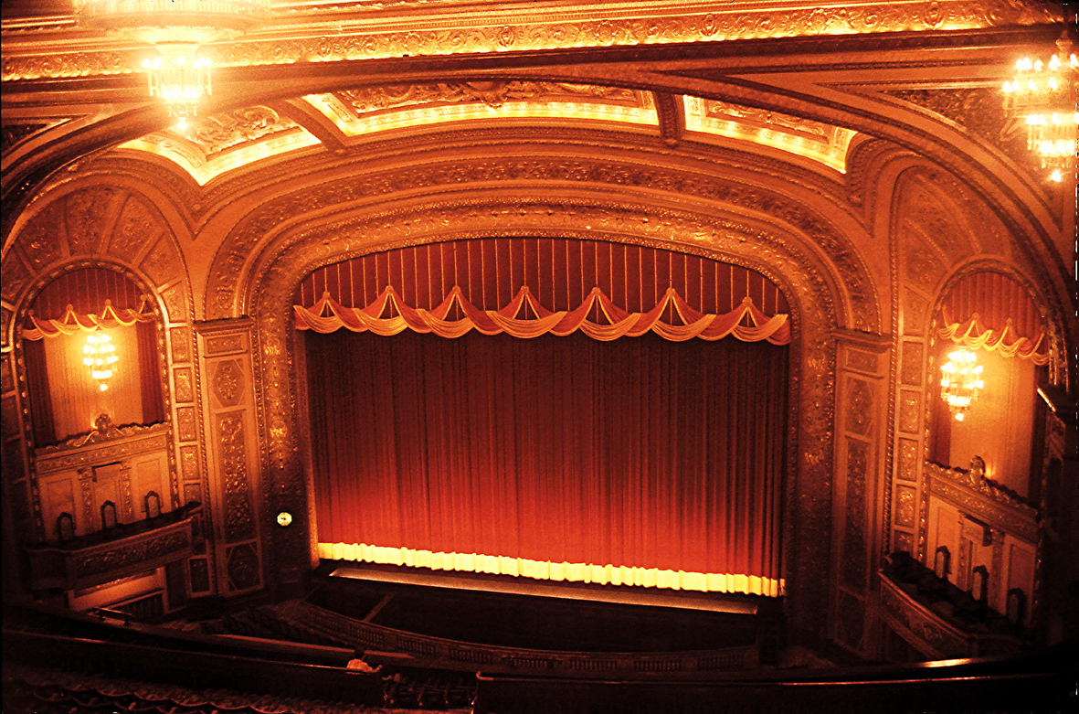
Proscenium

Slide 3
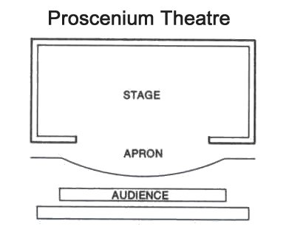
Proscenium
Defined by proscenium arch that creates a “picture frame” around the stage.
Audience is on one side.
The most traditional of all theatre styles

Slide 4
Proscenium
Pros:
Easy to stage and build sets for.
Best sight lines
Cons:
Limited to existing structure
Least intimate of the theatre spaces

Slide 5
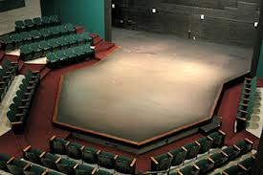
Thrust Stage

Slide 6
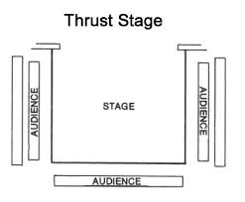
Thrust Stage
Defined by stage coming out into the audience.
Audience surrounds three quarters of the stage.
Stage can be level with the audience, or sit higher.

Slide 7
Thrust Stage
Pros:
More intimate theatre experience. Actors are closer to the audience
Allows for my participation from audience.
Visually interesting.
Cons:
Limits staging and sets; both from sight lines and height issues

Slide 8
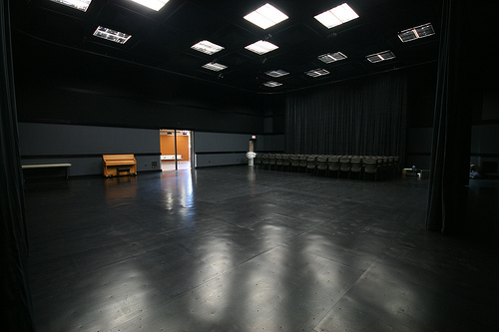
Black Box

Slide 9
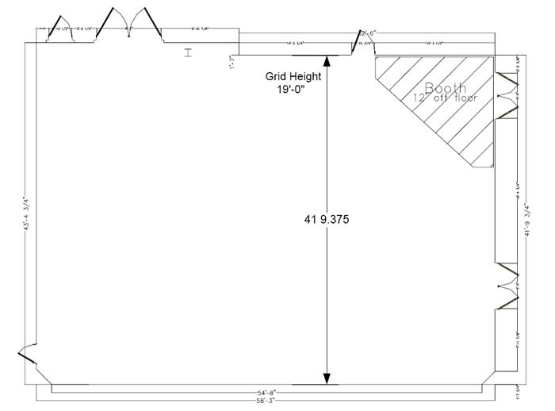
Black Box
Defined by large empty space, it is a literal black box
Space can be arranged in what ever matter you want.
Most diverse stage

Slide 10
Black Box
Pros:
Most diverse space; can be arranged in whatever matter is needed.
Allows for the most interesting and unique theatre experience and intimacy with audience.
Cons:
Can be the most expensive to build for.
Limited space.

Slide 11
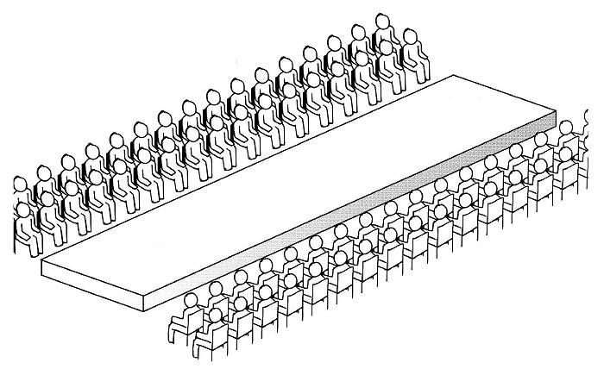
Traverse Stage

Slide 12
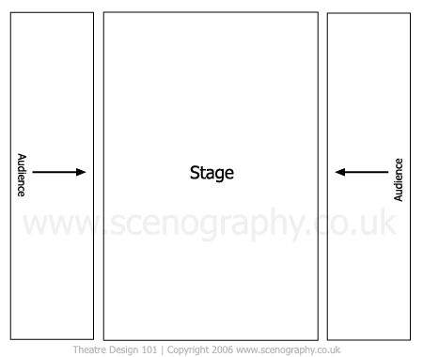
Traverse Stage
Defined by the stage sitting between two halves of the audience. The audience sits on both sides.
The rarest of traditional theatre types

Slide 13
Traverse Stage
Pros:
New prospective on a theatre piece because it is not traditionally used.
Cons:
Sight lines with both set pieces and actors.
Actors are always giving their back to half the audience at any given time.
Not a very wide stage.

Slide 14
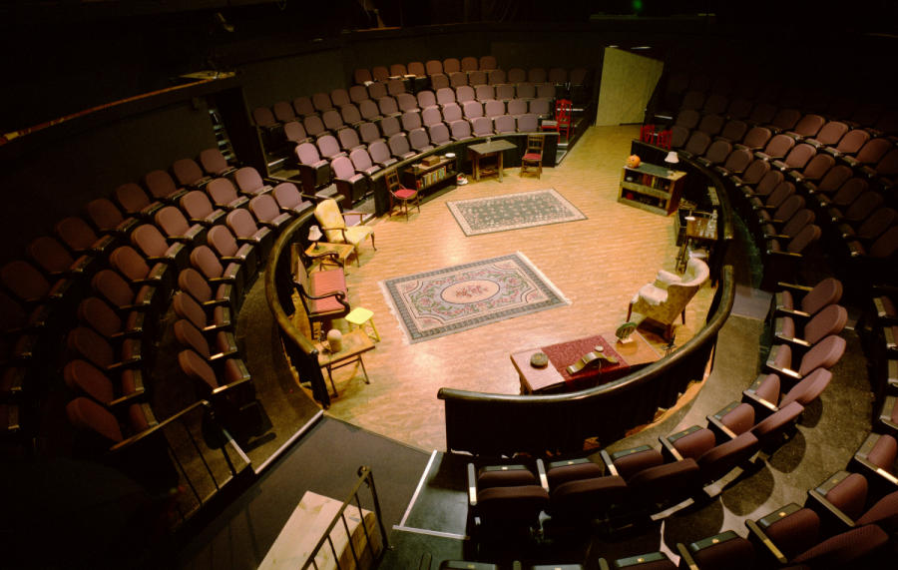
Theatre in the Round

Slide 15
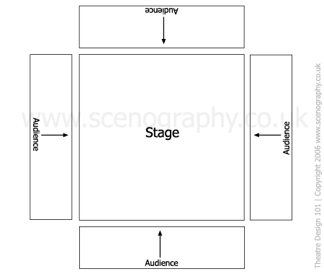
Theatre in the Round
Defined by audience on all four sides. The audience is literally sitting around the stage

Slide 16
Theatre in the Round
Pros:
Very intimate style of theatre.
Very dynamic.
Cons:
Extremely limited sight lines for sets and actors.
Actors are showing three quarters of the audience their back at any moment.

Slide 17
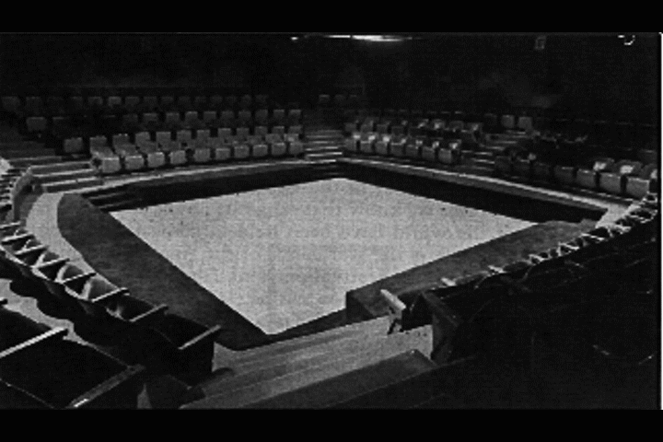
Arena Stage

Slide 18
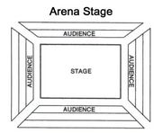
Arena Stage
Defined by extremely elevated seats.
Similar to the theatre in the round, but the seats are much more elevated.

Slide 19
Arena Stage
Pros:
Higher seats allow for better sight lines
Cons:
Sets are still limited because of sight lines
Actors still show their backs to three quarters of the audience at any given time.

Slide 20
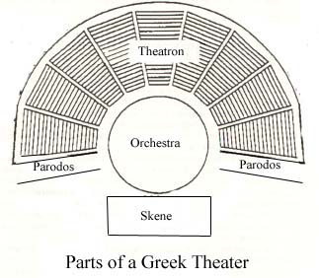
Amphitheatre
Defined by its outdoor location.
Commonly a three quarter arena stage.
Most commonly seen in Ancient Greek Theatre

Slide 21
Amphitheatre
Pros:
Outdoor theatres allow for bigger audiences.
Set can be elaborate or quite minimal for the space.
Cons:
It’s outside…..most areas have actual weather….or heat here in the desert.
Not all amphitheatre have electricity.

Slide 22
Type of Stages
Any Questions?

