Slide 1
The Color Wheel
Let’s reinvent the wheel….by adding color

Slide 2
COW

Slide 3
The Color Wheel

Slide 4
And again ☺

Slide 5
But here is a more complicated one.
As you move closer to the center of the circle, each color gets darker. It is the SAME color, but a different HUE
Hue = Shading from dark to light

Slide 6
What can the color wheel tell us?
Complementary colors are two colors that are the EXACT opposite of each other on the color wheel.
For Example: Blue and Orange
These two colors next to each will visually pop.

Slide 7
Blue and Orange

Slide 8
Yellow and Purple

Slide 9
Red and Green

Slide 10
Shall we get a bit more color wheel complicated?

Slide 12
Complementary Colors

Slide 13
Rectangle Color Scheme

Slide 14
Analogous Color Scheme

Slide 15
Triadic Color Scheme

Slide 16
Square Color Scheme

Slide 17
Split-Complementary Color Scheme

Slide 18
Now for your assignment
Due Next Friday 9/26
You must create your own color wheel collage using magazine pictures
It must be in a circle and be a complete color wheel
It should be on a standard piece of paper…or larger
It should be a thorough as possible.

Slide 19
This is a poor example…why?
Level One

Slide 20
This is one step better…why?
Level
Two

Slide 21
This is better still…why?
Level Three

Slide 22
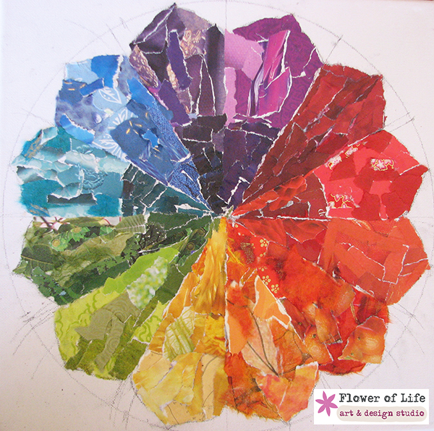
Why are these the best?

Slide 23
What you will be graded on:
How thorough is it? Did you include all the colors?
How neat is it?
Is it actually a collage? Did you use multiple pieces?
Was it on time?
Any Questions?

