Slide 1
Monday 9/29
No Q.OD:
Warm Up = Is there a time when people should NOT be wearing makeup, explain and give an example
NEW UNIT = MAKEUP

Slide 2
Makeup Learning Target (write this down) = SWBAT recreate step by step various special effects techniques, including black eyes, burns and lacerations and SWBAT apply knowledge of color to various makeup techniques to create two opposite clown designs

Slide 3
Weekly COW

Slide 4
Essential Questions for Today
What can a person accomplish with makeup?
Take notes on each slide, even if there are no typed out words
First a video clip to begin the power of makeup

Slide 5
This isn’t makeup
This is CGI = Computer generated images
Most special effects in movies today are CGI

Slide 6
However the base layer was makeup

Slide 7
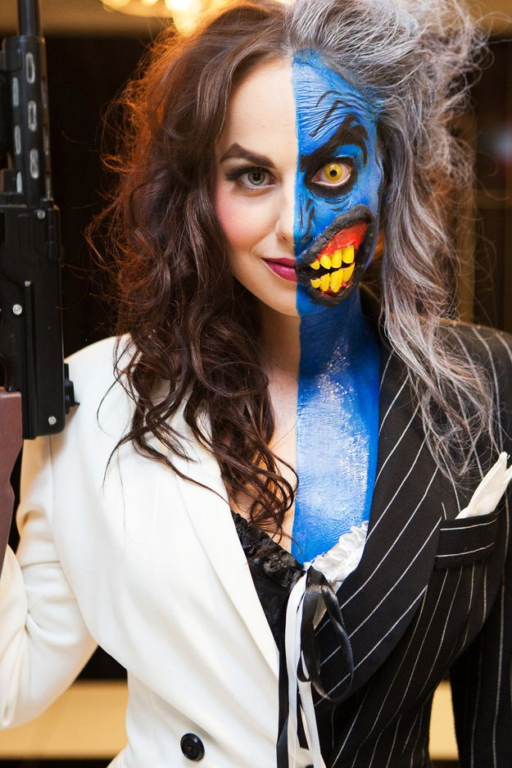
And these are all two faced created by everyday people

Slide 8
This is her step by step pictures

Slide 9
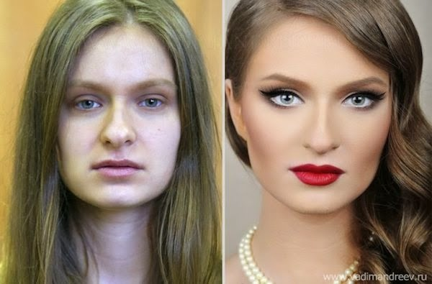
It can make you prettier

Slide 10
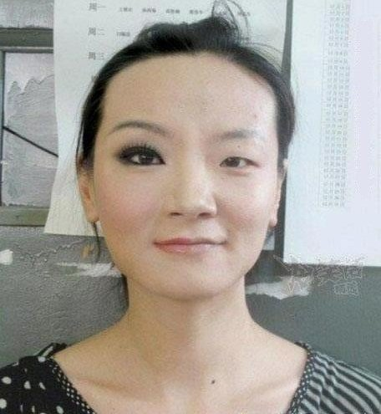
It can make your eyes pop

Slide 11
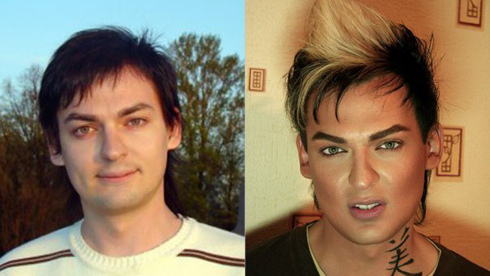
It works on men too

Slide 12
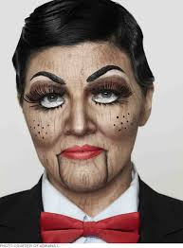
It can turn you into a character

Slide 13
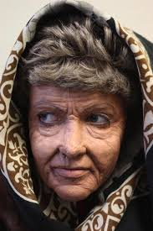
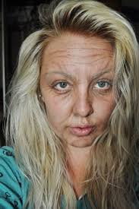
It can turn you old

Slide 14
It can turn you young

Slide 15
And now for the largest transformation

