Slide 1
1/7: WU : Answer the scale questions below
Convert the following in 1” scale:
2’2” =
1’5” =
3’6” =
Convert the following in ½” scale:
5’2” =
4’6” =
3’1” =
Convert the following in ¼ “ Scale:
2’1” =
1’3” =
.75’ =

Slide 2
Daily Learning Target
SWBAT to review tool usage and safety, ground plans and scale to be able to understand how to read the Seussical plans
Jigsaw
Circular Saw
Screwdrivers (Phillips and Flat Head)
Nails vs. Screws
Muslin

Slide 3
Snow…Bad

Slide 4
Ewwww

Slide 5
Hi Daddy

Slide 8
Jigsaw
Used to be called scroll saws
Made up of an electric motor and a reciprocating saw blade (aka it moves up and down)
It is easier to start the blade right before the wood than at the wood
Best on intricate lines

Slide 9
Circular Saw
A saw with a toothed or abrasive circular blade that spins
Circular saw specifically refers to the handle held type; table or chop saw refer to the mounted types
Object you are cutting is mounted securely and you slowly ease the saw through it

Slide 10
Screwdrivers
Most common three types are Phillips, Slotted (or Flathead) and Hex Keys
A flat head screwdriver can loosen a Phillips head, but a Phillips head cannot loosen a flat headed screw

Slide 11
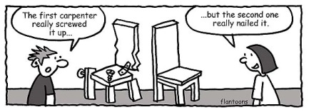
Nails vs. Screws
Hammers are used on nails AND Screwdrivers are used on screws….just as a reminder

Slide 12
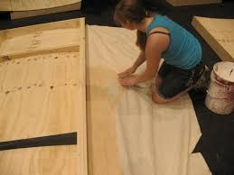
Muslin
Thin cotton fabric used to stretch over wooden frames to create soft flats
Makes a smoother paintable surface for sets

