Slide 1
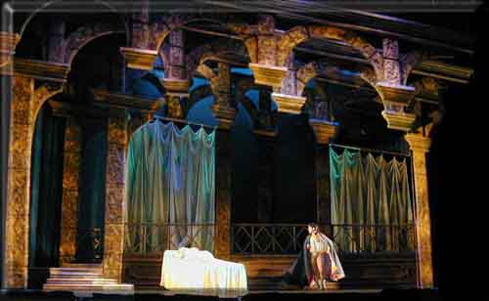
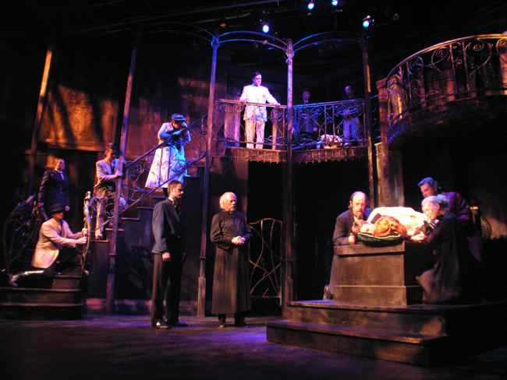
Tuesday 1/13 Warm Up: Write 3 differences and 3 similarities between these two pictures.

Slide 2
Tuesday January 13th, 2015
Unit Learning Target: SWBAT design and create a model of a theatrical set. Students will demonstrate their understanding by creating a practical and accurate set.
Daily Learning Target: SWBAT learn the differences in the various types of sets by taking notes and comparing them to each other.

Slide 3
Now with those six things:
Turn to the person next to you and share your lists – 3 minutes
Circle one difference and one similarity that you thought was the most interesting – 2 minutes
Then turn back from and be ready to take notes

Slide 4
So what were the differences/similarities?

Slide 5
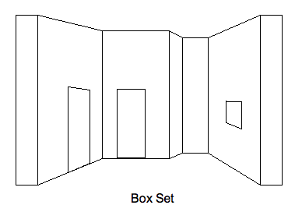
Types of Sets:
Box Set:
Set consists of 2 or 3 walls and maybe a ceiling
Most common type of set
Meant to look like a room
Solid walls – Does not move

Slide 6
Box Set:

Slide 7
Box Set:
Question (Write down and answer): What other industry/form of entertainment uses box sets?

Slide 8
Answer: Single Location Television Shows

Slide 9
2nd Type of Set
Curtain Set:
Set that uses the drapes/curtains to create the location of the play/scene
Can either be movable or not
More abstract

Slide 10
Curtain Set:

Slide 11
Curtain Set:
Question (Write and answer): What can you do with curtains with lights that you can’t do with walls?

Slide 12
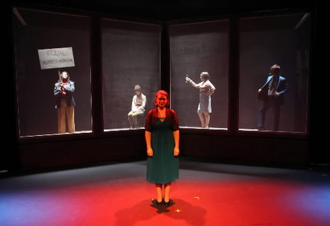
Answer: Transparent curtains with light passing through
Scrim = A curtain that is opaque (you can’t see through it) when lit from the front and transparent (you can see through it) when lit from behind

Slide 13
Or you can add color to the fabric:

Slide 14
What type of set is this?
Bonus: Who’s room is this?

Slide 15
Warm Up: Write 3 things you Know about this show
Decade/Years?
Time of the year?
Rich or poor?
Where in the country?
What’s going on in the scene?

Slide 16
Answers: The Game’s Afoot
December 1936
Connecticut Estate Home
Rich Broadway Star hosting a “murder mystery” party for his friends
Side note, one of them actually dies and the Broadway star takes on the character of Sherlock Holmes (his favorite) to solve the crime.

Slide 17
Set #3
Permanent Set:
A set that remains in place throughout the production
Elements (pieces) may be added, but the structure stays the same
Can be similar to a box set, however does not need to look like a room

Slide 18
Permanent Set
Write down a minimum 5 things you can infer (educated guess) about this set.

Slide 19
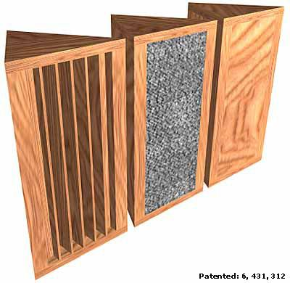
Set #4
Prism Set:
Uses Periaktoi (three sided set pieces on wheels)
Allows scenery to change by turning and rearranging the structures
Limited to three images
Saves LOTS of space

Slide 20
Prism (Periaktoi) Set

Slide 21
Set #5
Minimal Set
A set that uses only what is absolutely necessary
Very few pieces of furniture
Can be very abstract
Lowest costing set

Slide 22
Minimal Set

Slide 23
Set #6
Unit Set:
A set made of pieces that can be rearranged
Infinite amount of possibilities
Can be made of stock (standard pieces most theatres carry) pieces or custom pieces

Slide 24
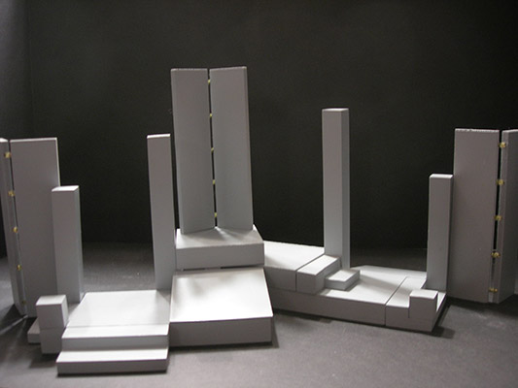
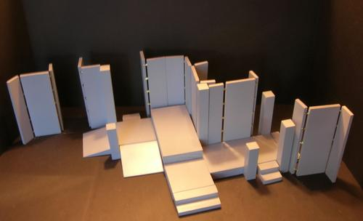
Unit Set – These are the same pieces rearranged

Slide 25
What type of set is this?

