Slide 1
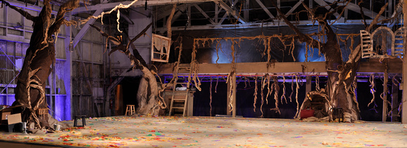
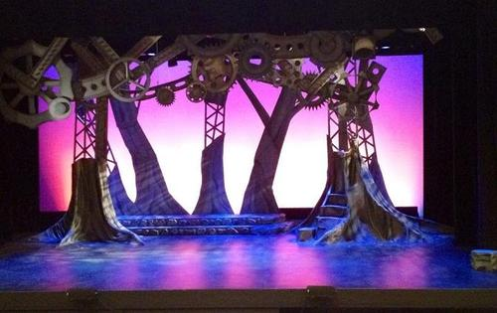
Compare these two photos: 5 Similarities and 5 Differences

Slide 2
Again…
Compare with the person next to you….
Circle One Difference and One similarity that stood out to you the most….

Slide 3
Set #3
Permanent Set:
A set that remains in place throughout the production
Elements (pieces) may be added, but the structure stays the same
Can be similar to a box set, however does not need to look like a room

Slide 4
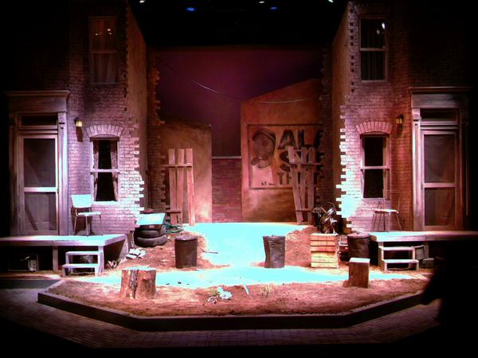
Permanent Set
Write down a minimum 5 things you can infer (educated guess) about this set.

Slide 5
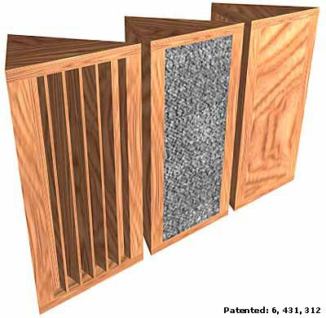
Set #4
Prism Set:
Uses Periaktoi (three sided set pieces on wheels)
Allows scenery to change by turning and rearranging the structures
Limited to three images
Saves LOTS of space

Slide 6
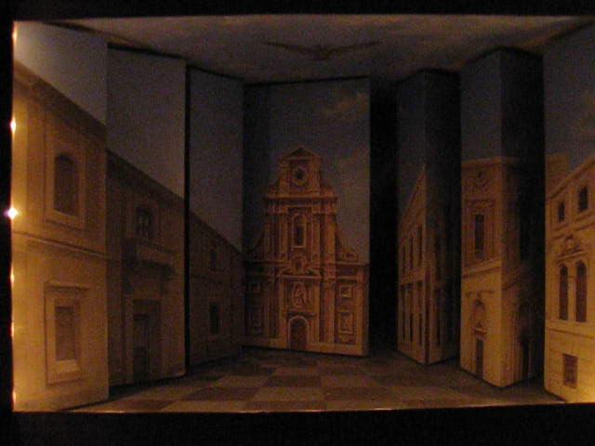
Prism (Periaktoi) Set

Slide 7
Set #5
Minimal Set
A set that uses only what is absolutely necessary
Very few pieces of furniture
Can be very abstract
Lowest costing set

Slide 8
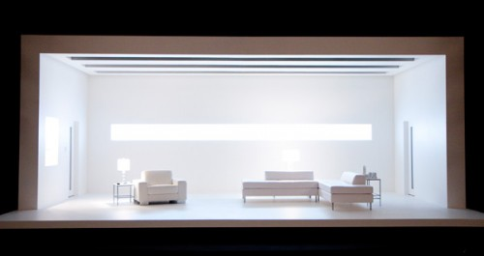
Minimal Set

Slide 9
Set #6
Unit Set:
A set made of pieces that can be rearranged
Infinite amount of possibilities
Can be made of stock (standard pieces most theatres carry) pieces or custom pieces

Slide 10
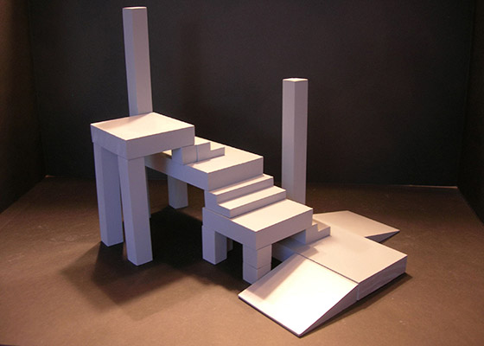
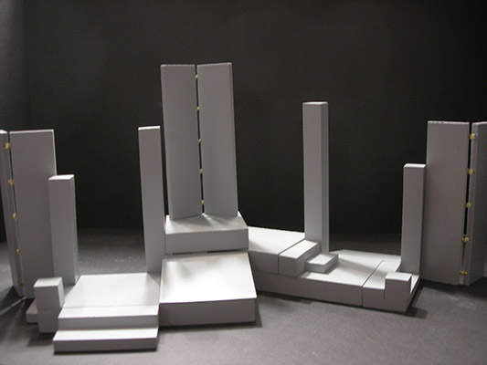
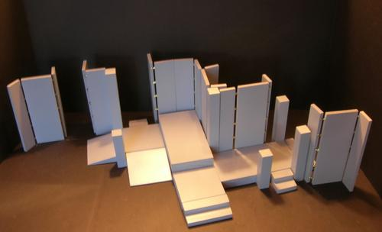
Unit Set – These are the same pieces rearranged

Slide 11
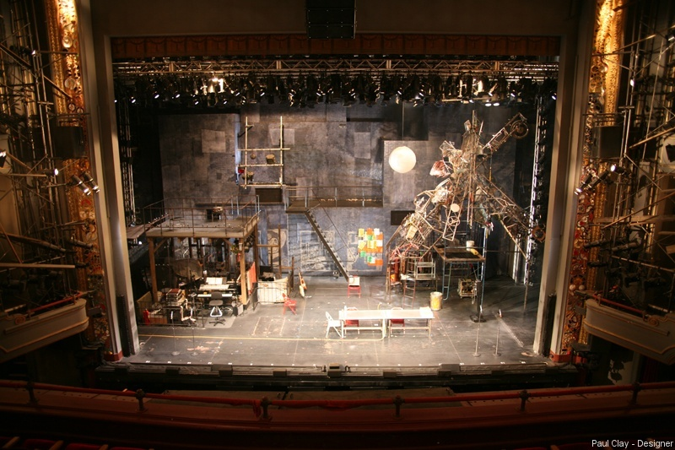
What type of set is this?

