Slide 1
Types of Stage Lights
Copy Each Slide – 2 minutes
Listen for Explanation – 3 minutes
Answer Question – 1 minute

Slide 2
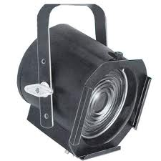
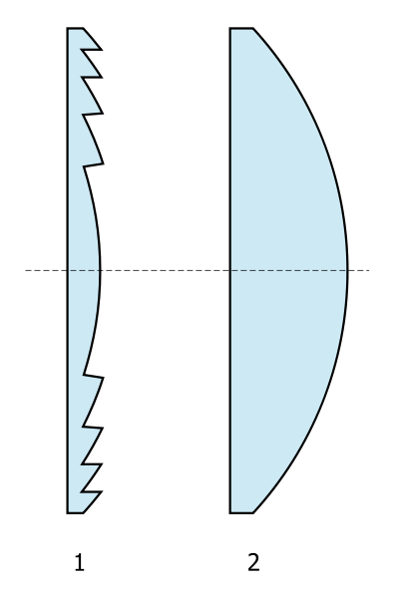
Fresnel (Pronounced Frah Nel)
Originally technology designed by Augustin Jean Fresnel to be used in light houses
The stepped design of the lens produces more light with less glass
Produces a soft wide spread of circular light
Cannot be focused
Can only be shuttered with the use of ‘barn doors’
Knowing that the fresnel lens produced more light with less glass, why do you think the technology was originally made for light house?

Slide 3
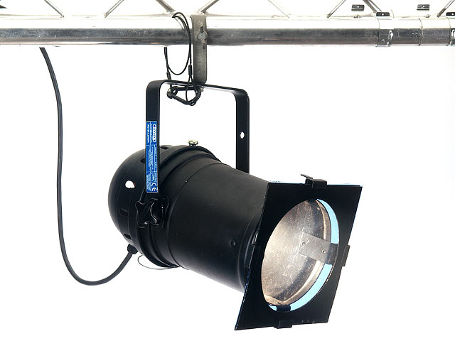
Parcan or Par
PAR = Parabolic Aluminized Reflector
Same technology as car head lights: one lamp, one reflector and a barrel
Large spread of light
Not focusable
You can’t change the shape of the light
Commonly used in rock concerts
Why is the Par used so often in concerts? What is different about the lighting needed for a rock concert than for a play?

Slide 4
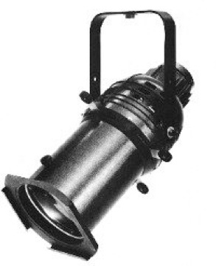
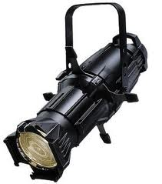
Ellipsoidal Spotlight (ERS)
Named for the ellipsoidal reflector that shines light down the barrel
Light produced is in the shape of an oval
Focus is a adjustable
Shape is adjustable with shutters
Common Names : Leko (top image) and Source 4 (bottom image)
Why do you think this light is considered to be the most versatile (most uses) fixture in all of stage lighting?

Slide 5
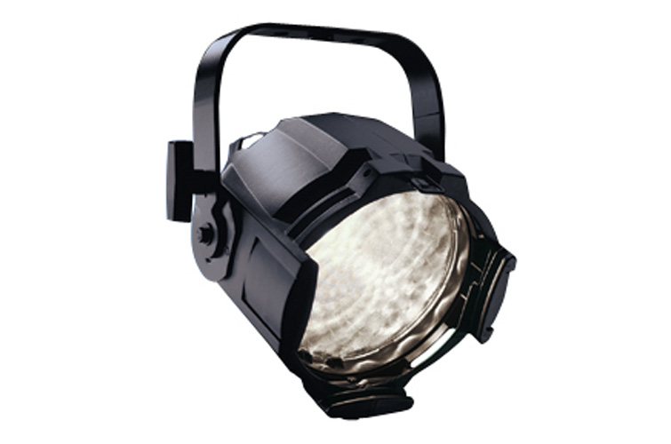
Source 4 Par
Created by the same company as the Source 4 (ETC = Electronic Theatre Controls)
It is a modern, more efficient design of an original Parcan
More expensive than a traditional par, but more efficient
If a more efficient fixture exists, why are people still using Pars?

Slide 6
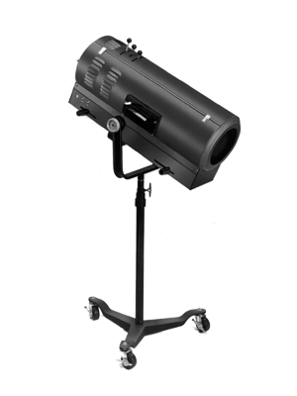
Spot Light
Operated by a person
Size of follow spot can adjust
Focus of follow spot can adjust
Contains own set of colors

Slide 7
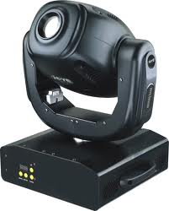
Moving or Intelligent (Intels) Lights
Known as moving lights, intelligent lights or intels
Programmed on a separate computer or light board for each cue
Can change position, size, color and some even have patterns
Extremely expensive and significantly heavier too
Other than the price, what is a major issue with moving lights?

Slide 8
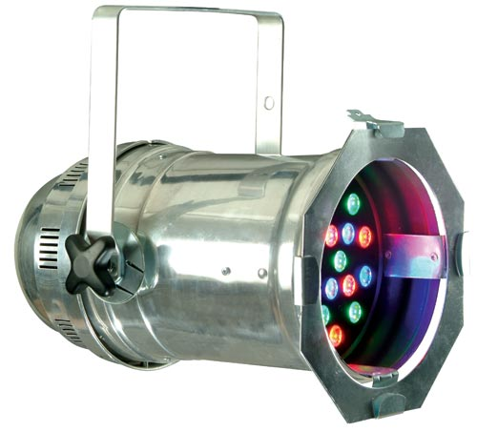
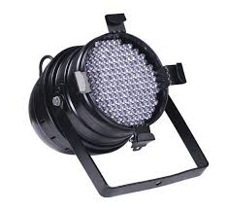
LEDS
LED – Light Emitting Diodes
Lights are EXTREMELY expensive, but have a longer life span
Lights produce more light with less heat
Lights use less energy
Lights can produce own color (and can change per show)
This is the new trend in stage lighting technology, but LEDS are not new. Where else have LED lights been used for the last two decades?

Slide 9
Exit Ticket
To be able to leave class you must:
Have all of your notes from today
Have all of the short questions written down and answered
Lastly, re-answer this question:
Why are there so many different types of stage lighting fixtures?

