Slide 1
Types of Stages Game
In your group right which type of stage (or types of stages) and then the evidence you used to make that decision

Slide 2
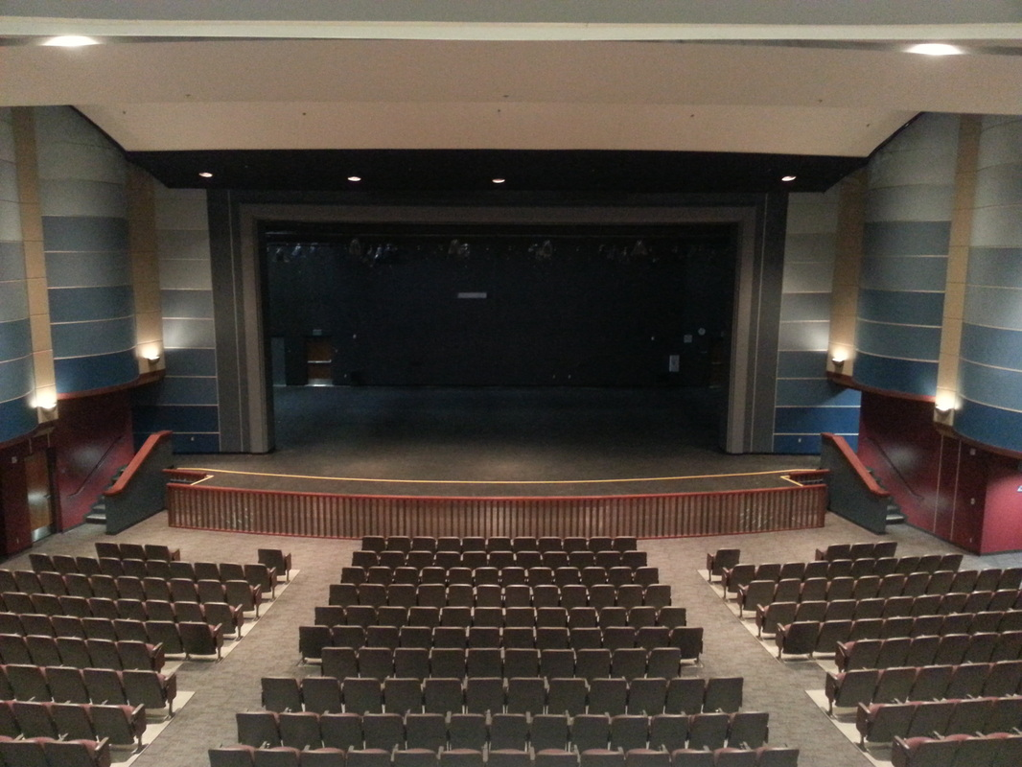
1

Slide 3
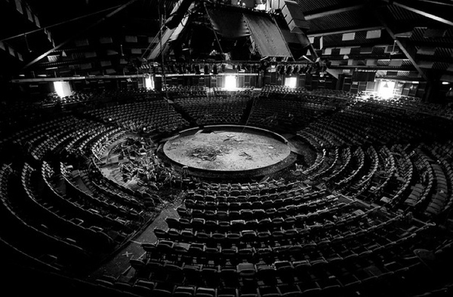
2

Slide 4

3

Slide 5

4

Slide 6
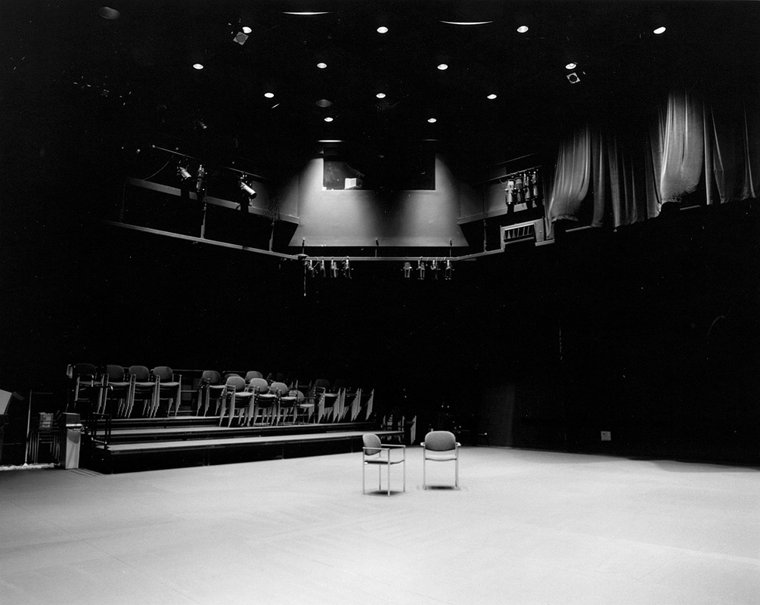
5

Slide 7

6

Slide 8
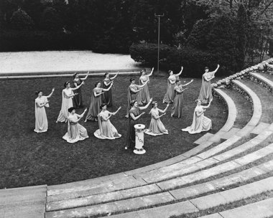
7

Slide 9

8

Slide 10

9

Slide 11

10

