Slide 1
Visual Research Warm Up: What is research? Obj/Eq: What is good visual research?
Q.O.D: Favorite Halloween Candy/Treat

Slide 2
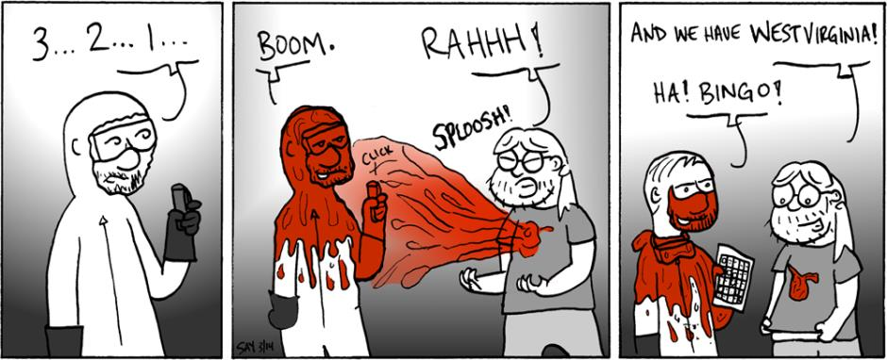
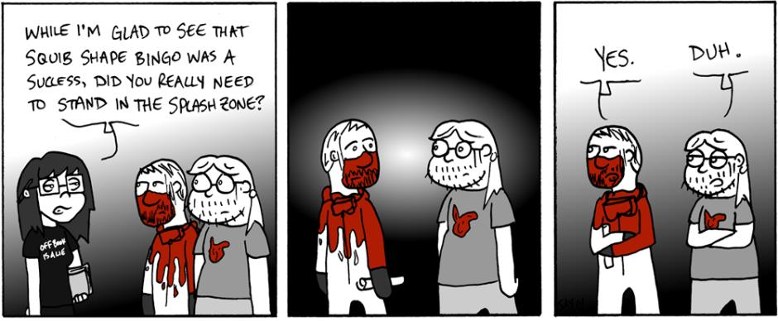
Weekly COW

Slide 3
Visual Research Game
Rules:
Do NOT call out the answer
Write down every guess you make, no matter how strange and write down the correct answer as well
All pictures will be on the first page of image results
All pictures will not be blocked by the schools network.
Some of them are going to be obvious…some of them are not

Slide 4
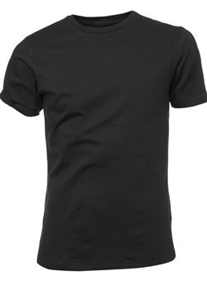
Image Number 1
What is it?
Answer: Black Tshirt

Slide 5
Image Number 2
Is it a thing or a place?
Answer: School

Slide 6
Image Number 3
What is he?
What adjectives are associated with him?
Answer: Happy Clown

Slide 7
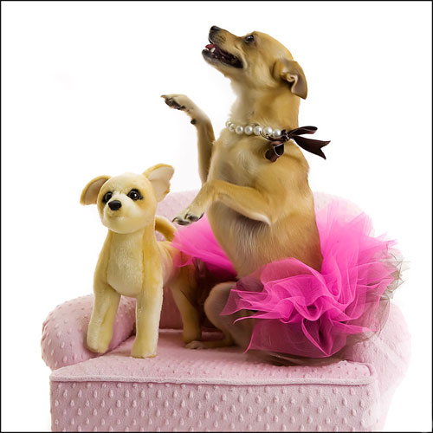
Image Number 4
What is it?
Answer: Dog in a tutu

Slide 8
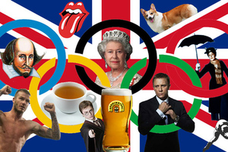
Image 5
What do these things all have in common?
What could the question, if this was the answer?
Answer: Most British Photo ever

Slide 9
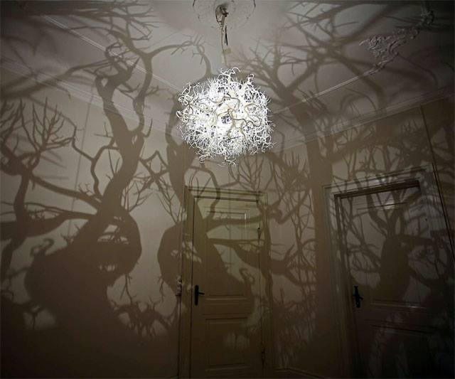
Image 6
What is it?
What adjectives come to mind?
How might this be useful in a design?
Answer: Spooky Light

Slide 10
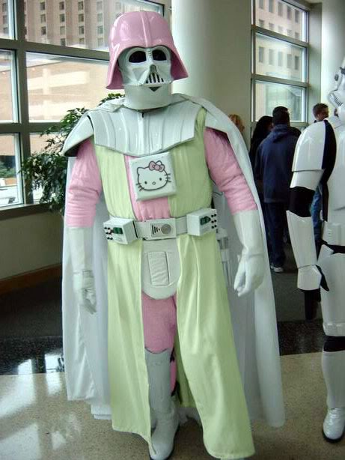
Image 7…just for fun
Who is this?
Who is the other character?
Answer: Funky Darth Vader OR Hello Kitty Darth Vader

Slide 11
Rules to good Visual Research
The more images the better…to a point
Adjectives, adjectives, adjectives
Sometimes look up the obvious
Synonyms are your friends
Synonyms – words with the same or similar meaning
Don’t just copy off of one image

