Slide 1
What is technical theatre?

Slide 2
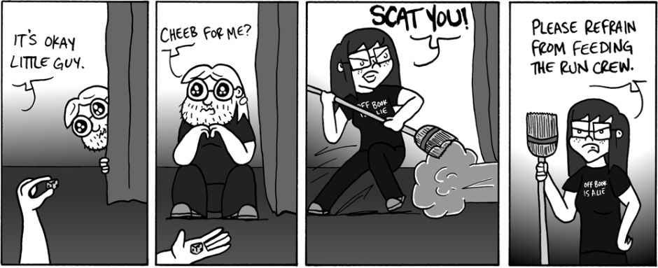
Weekly Comic 8/25

Slide 3
What is technical theatre?
“Anything on stage except for the actors”
Lights
Sets
Costumes
Makeup
Special Effects
Sound
Stage Management
And more…

Slide 4
What can I do with this knowledge?
There are many jobs that fall under the specs of technical theatre
Every theatre, touring show, concert, award ceremony, even large parties have theatre technicians
Our union (organization that regulates
our pay and protects us) is called
I.A.T.S.E (International Alliance of
Theatrical Stagehand Employees)

Slide 5
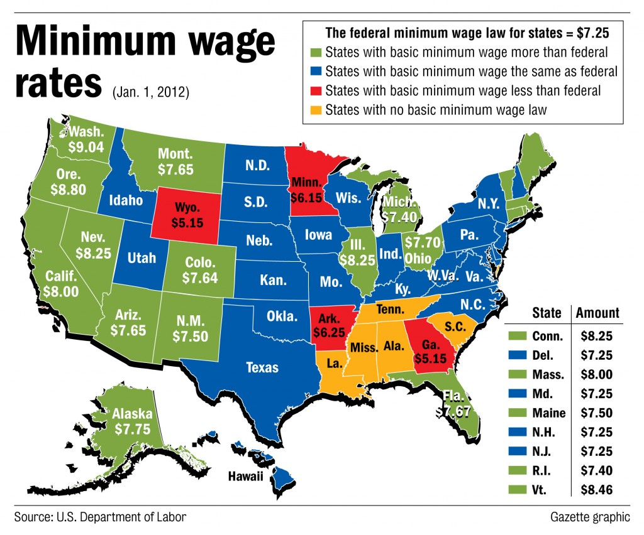
How much money can that make me?
Minimum wage in the country is $7.25, California minimum way is $8 dollars per hour.
Average work week is 40 hours.
That’s $320 a week and $16,640 a year……that’s not a lot.

Slide 6
Local IATSE Chapter
Average starting hourly rate for the local IATSE chapters is $30 an hour
Or $1200 a week (if working a full 40 hour week)
Or $62,400 a year (which is a VERY nice yearly wage)
So why the money?
IATSE Does not require a college education, you can be getting paid this much with just a high school diploma and you get paid more when you are more skilled.

Slide 7
So now back to technical theatre
Stage Directions:
Are from the actor’s position!
When standing on stage and looking at the audience, stage left is to the actor’s left and stage right is to the actor’s right.
So if you are in the audience looking at the stage:
Your left = Stage Right
Your right = Stage Left

Slide 8
Up Stage and Down Stage
If standing on stage and walking towards the audience, you are walking DOWN STAGE
Stages used to be raked: meaning they were slanted so that every audience member could see everyone on stage.
So walking towards the audience meant you were literally walking down the stage.
So walking away means you are walking UP STAGE

